Slide 1
SPEAKER INSTRUCTIONS
Please go through these slides before presenting. There are several places where you need to update the slides for the audience you’re targeting.
The demo code supporting these slides is available in four flavors: .NET, Java, Python, JavaScript.
Choose the version most appropriate for your audience and delete links to other versions throughout the deck. (Or, leave and just note for your audience which you’ll be using.)
There is a talk track available in the slide notes to help you understand the purpose of each slide.
Please ask your audience to join the Microsoft AI Discord to continue the dialog and get more help on MCP from across the community and Microsoft: https://aka.ms/AzureAIFoundryDiscord

Slide 2
Let’s Learn MCP Model Context Protocol
Season of AI
<SPEAKER NAME, Title>
Notes:
Speaker Introduction

Slide 3
Agenda
What is MCP? How does it work? How do you use it?
In-depth overview of MCP features
Real-world scenario – The Microsoft Learn MCP Server
Building an MCP server
Tutorial: https://aka.ms/letslearnmcp-csharp
https://aka.ms/letslearnmcp-java https://aka.ms/letslearnmcp-python
https://aka.ms/letslearnmcp-javascript
Notes:
Here is what we are going to look at today.

Slide 4

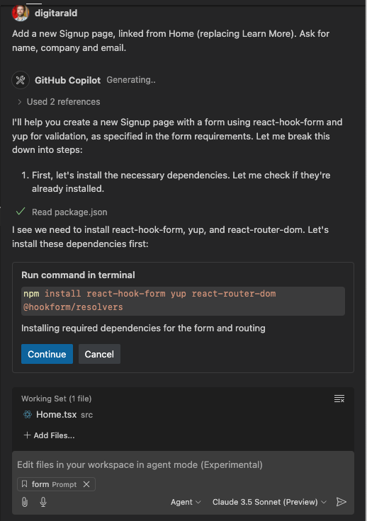
But how do we provide real time context? How do we connect to our database? Query GitHub Issues? Run tests with natural language? How can we bridge the gaps between our code, the client and LLM, and everything else?
Agent mode
Agentic coding
Accelerate delivery by shifting from code to outcomes
Autonomous AI pair programmer that plans, executes, and iterates on multi-step coding tasks – from editor to terminal, tests to debugger.
Notes:
We've seen massive shift in the AI assisted coding space over the past few months. Previously, we could interact with clients like GHCP by asking them questions, having them help us with code completion, or even using them to help edit a file. Now, in VS Code and Visual Studio, we have agent mode which makes Copilot even more helpful by turning into a real autonomous AI programmer. Now, when you ask agent mode for assistance with something, it can plan, execute, and iterate on multi-step task. It can execute terminal commands, edit code, run tests, debug...
[click]
That alone is pretty powerful but is still missing a key piece: real time context. How can we make Copilot aware of our external databases? How can we show it the issues coming into our GitHub repo that we need to address and use it to create the fixing PR? How can we connect it with the tools and resources that are not part of our IDE but are still necessary to our projects?

Slide 5
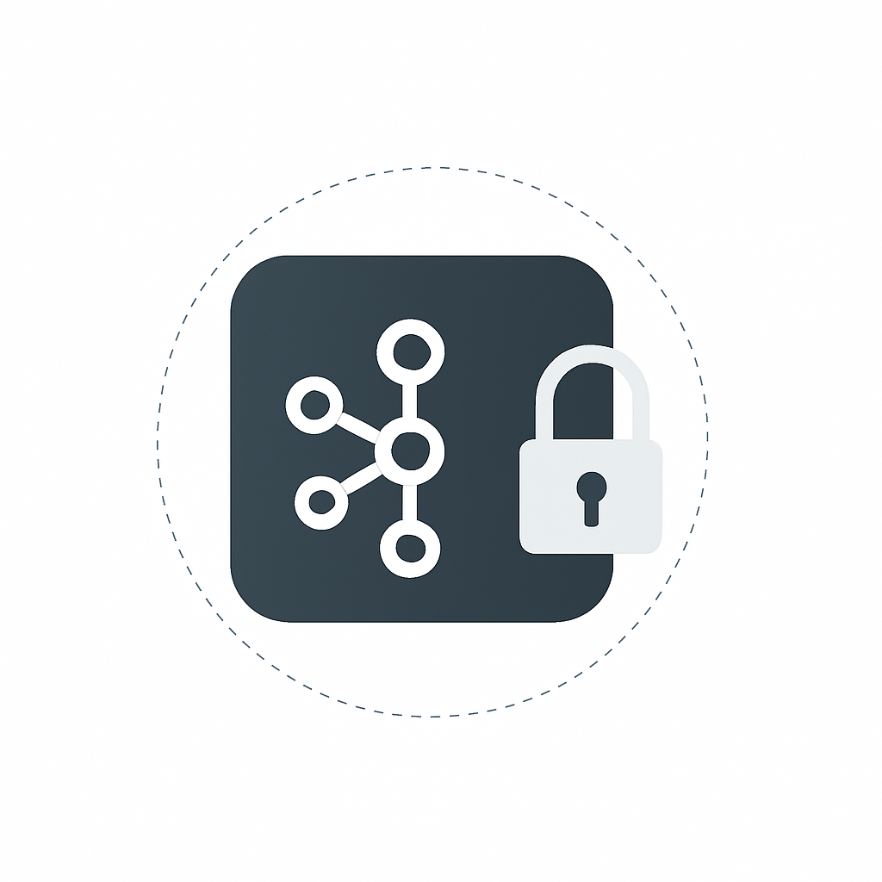
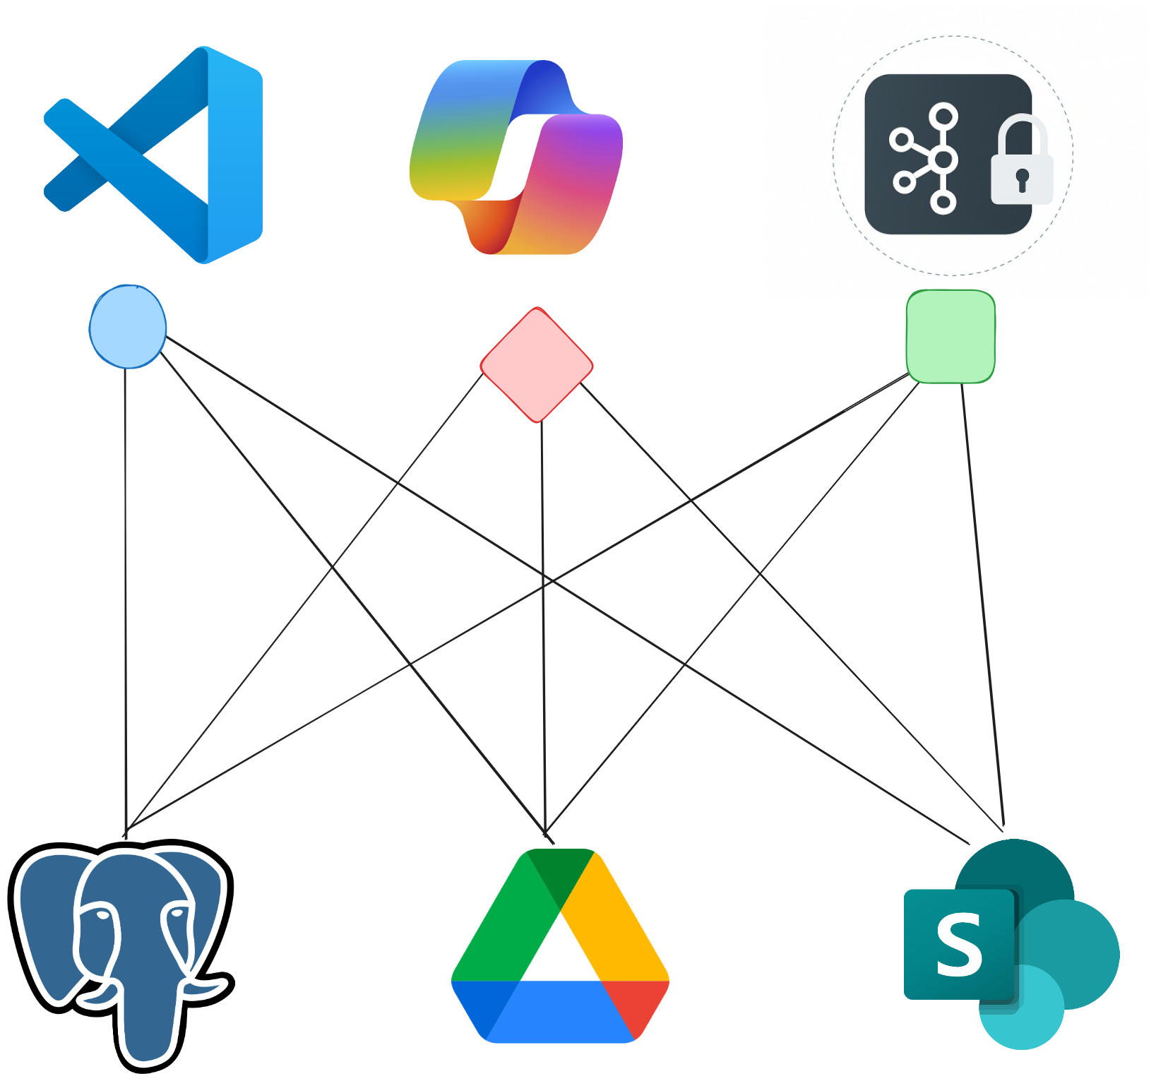
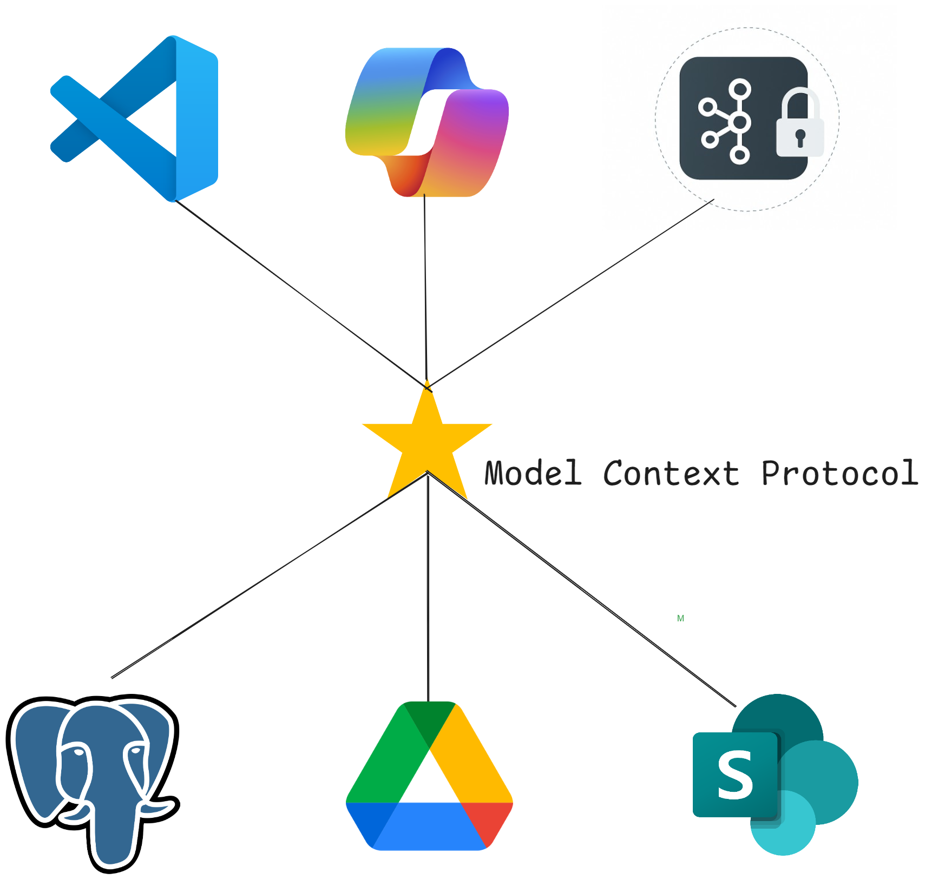
The need for MCP arises – a Timeline
Tools are integral to Agent performance
Integration chaos!!!
The need for a standard (MCP)
Notes:
Developers have been working to come up with solutions to integrate with different external tools and capabilities...
[click]
BUT every new integration required its own custom implementation which led to an explosion custom extensions and plug-ins. This increased maintenance, security, and performance risks, and was really difficult to scale.
For example, if you're developing an app and want to connect to different data sources or services you would need to install several extensions, open several web pages, or build a custom solution.
Or, if your company has a bunch of different data sources that are managed by different teams, they may all be implementing external data integrations differently which can be confusing and redundant.
[click]
That's where MCP comes in...

Slide 6
MCP is an open protocol that standardizes how applications provide context to LLMs. It’s like USB-C but for AI
Notes:
MCP servers provide a standard way, or protocol, to connect LLMs with data, tools, and resources. The MCP website describes MCP as a universal adaptor for AI applications. In the same way that a universal adaptor lets you connect your physical devices to accessories, MCP lets you connect AI applications to other data and tools without needing to build a custom connection to each data source.

Slide 7
Model Context Protocol Created by Anthropic Adopted by the AI community Evolving Together
Notes:
The important thing to remember is that Model Context Protocol is adapting and evolving as AI changes. It was created by Anthropic and has been adopted as a standard throughout the AI community.

Slide 8
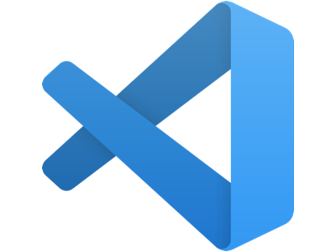
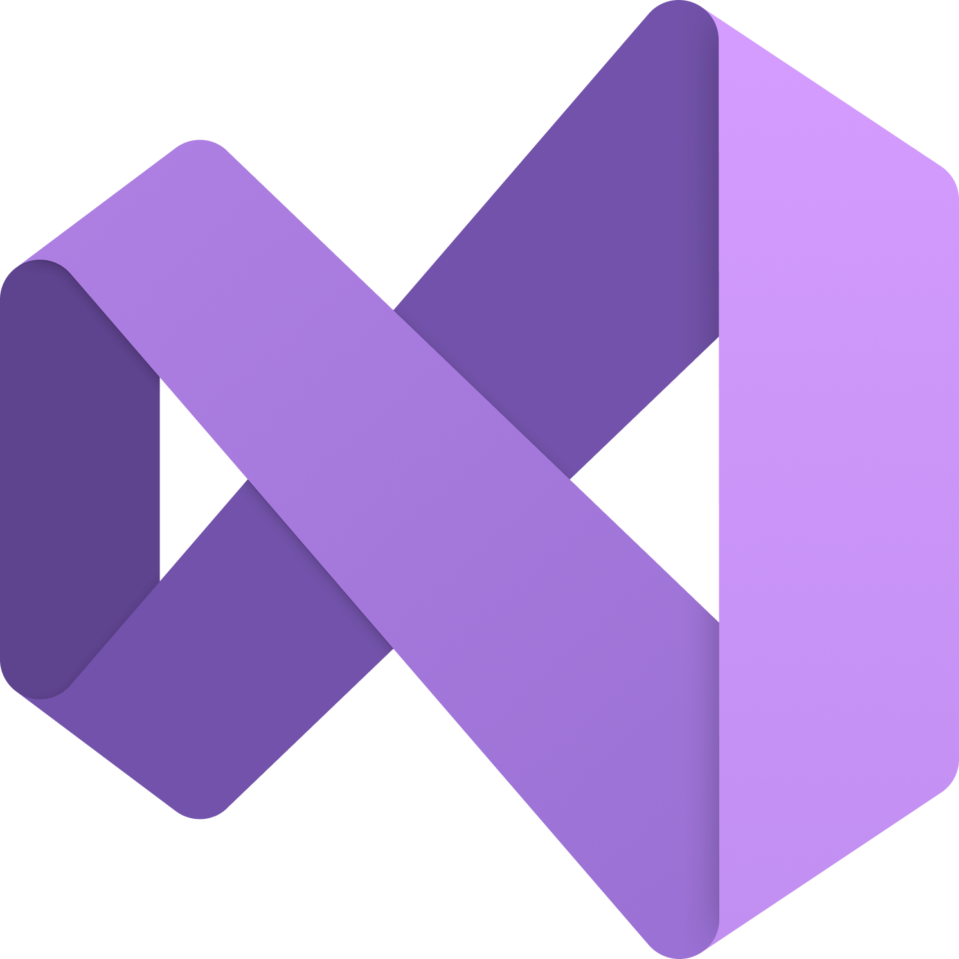

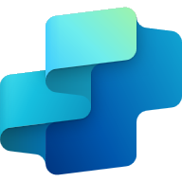

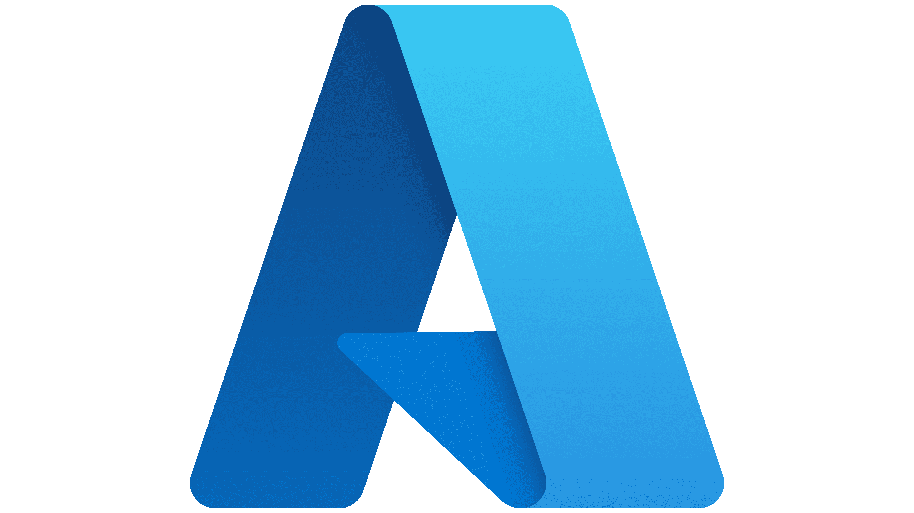




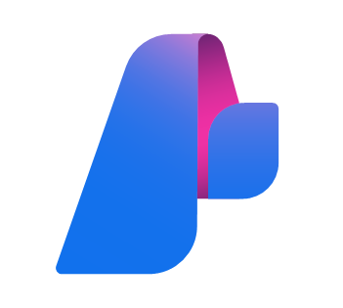

Parts of MCP
Hosts
Clients
Servers
Notes:
There are 3 main parts to know about when talking about MCP
Hosts: programs like VS Code, Copilot Studio, IDEs, or AI tools that want to access data through MCP
Clients: Protocol clients, which sometimes are the same as the host, that maintain 1:1 connections with servers
Servers: Lightweight programs that each expose specific capabilities through the standardized Model Context Protocol. You can build your own servers or use on of the many servers that's already out there.
For example, you can connect directly to your database and analyze schemes, pull in information from GitHub repos such as issues and pull requests, automate end-to-end testing with Playwright, or you can even build your own servers with several SDKs including C#!

Slide 9
Demo
SPEAKER PREP: Choose the best link for your audience
Setting up & using MCP servers aka.ms/letslearnmcp-csharp
aka.ms/letslearnmcp-java
aka.ms/letslearnmcp-python
aka.ms/letslearnmcp-javascript
Notes:
let’s take a look.

Slide 10
MCP Deep-Dive Adapted from Mahesh Murag (Anthropic) AI Engineer session
MCP Client
Invokes Tools
Queries for Resources
Interpolates Prompts
MCP Server
Exposes Tools
Exposes Resources
Exposes Prompts
Tools
Model-controlled
Functions invoked by the model
Resources
Application-controlled
Data exposed to the application
Prompts
User-controlled
Pre-defined templates for AI interactions
Retrieve / search
Files
Document Q&A
Send a message
Database records
Transcript Summary
Update DB records
API Responses
Output as JSON
Notes:
To recap what we have done so far is created a new project, saw how we can integrate in the GitHub MCP server to query, create, and update issues on GitHub, directly from VS code. We also connected to a data source, in this case the Monkey MCP that exposed different data about the monkeys that we then used to help us craft our application.
[click]
Everything that we used was one of the features of MCPs called Tools. Think of them as functions that the LLMs can invoke to perform actions or get data.
[click]
But, there is more to MCP servers than just tools, including resources and prompts. So let’s go a bit deeper.

Slide 11
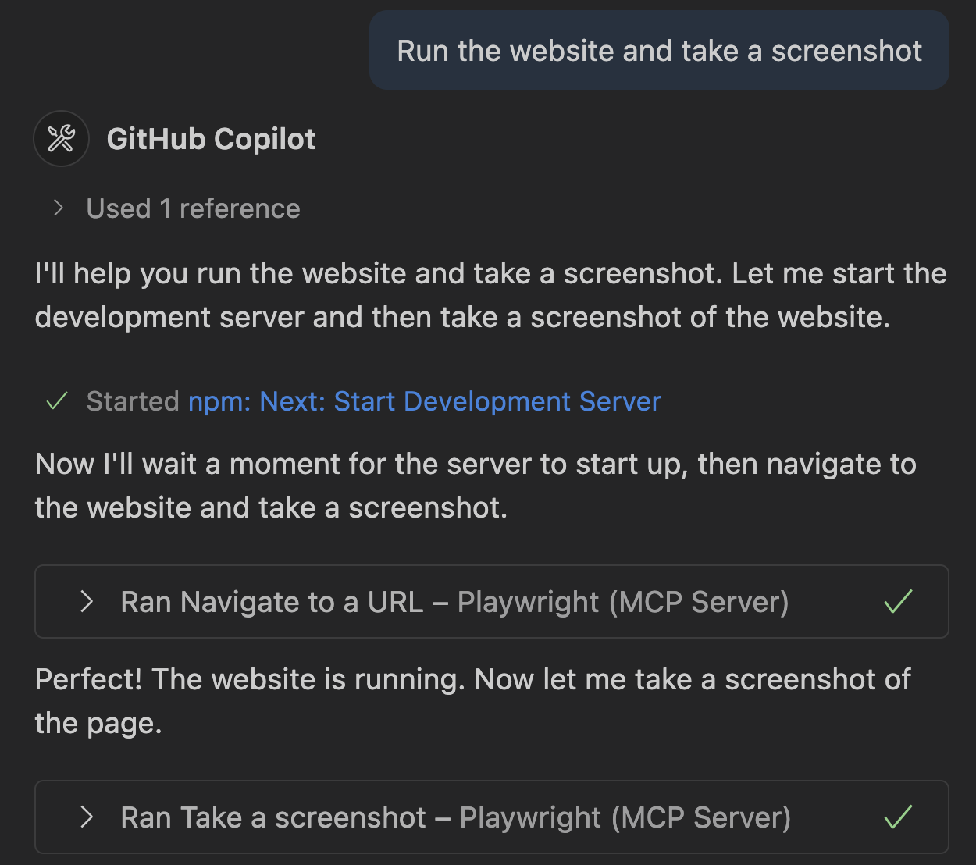
Tools
The popular basic primitive
Functions that LLMs can call to perform specific actions - basically function calling.
Send email
Update todos
Run tests
File issue bug
Notes:
Alright tools, as I mentioned and what we saw, are the core of MCP servers today. They allow you to get data, update data, or perform actions. What James showed was the ability to get data and also perform actions on GitHub. But there are a lot of use cases to stay in the flow including accessing your smart home, music services, or more. And of course there are a lot of developer focused MCPs, such as the Playwright MCP, you see here which allows you to navigate and explore your website through natural language.

Slide 12
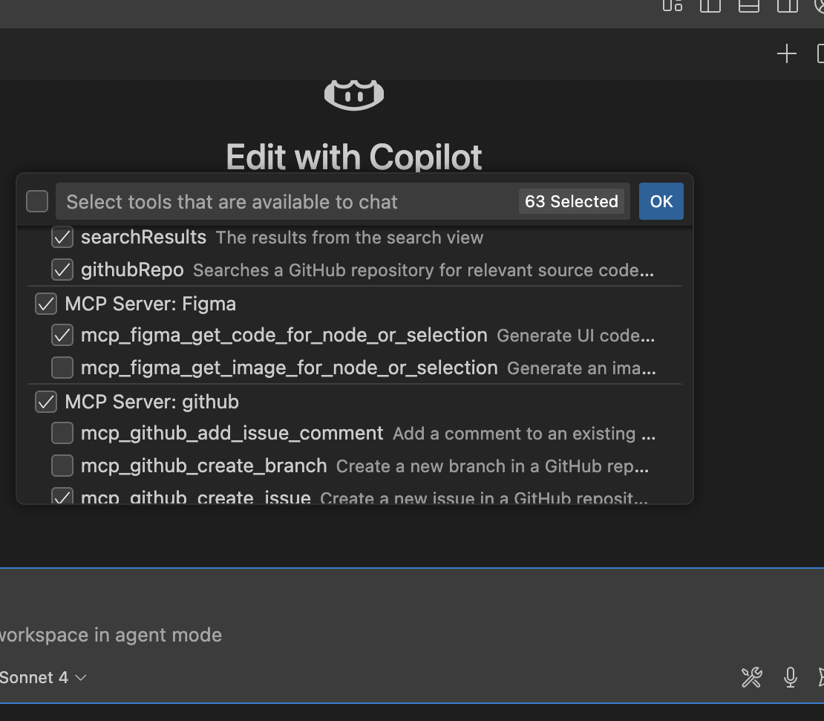
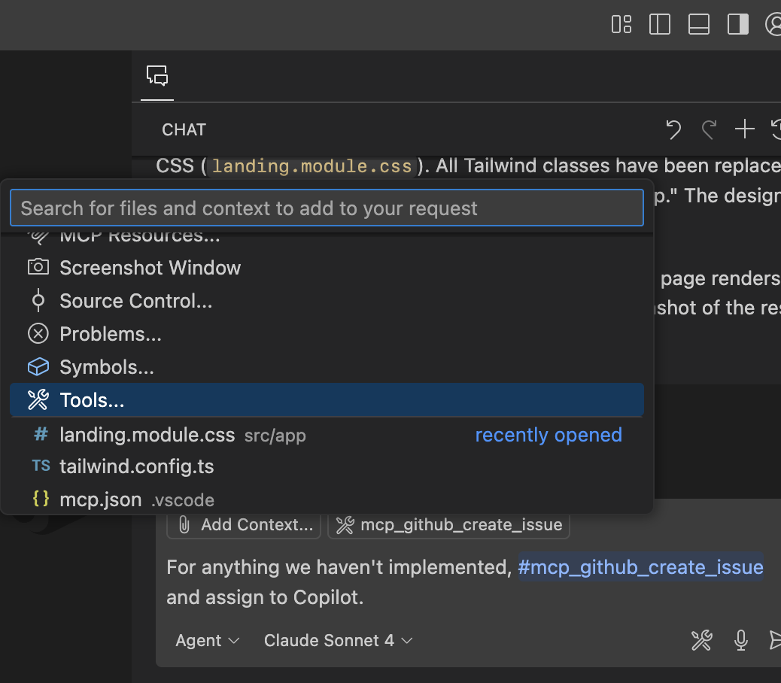
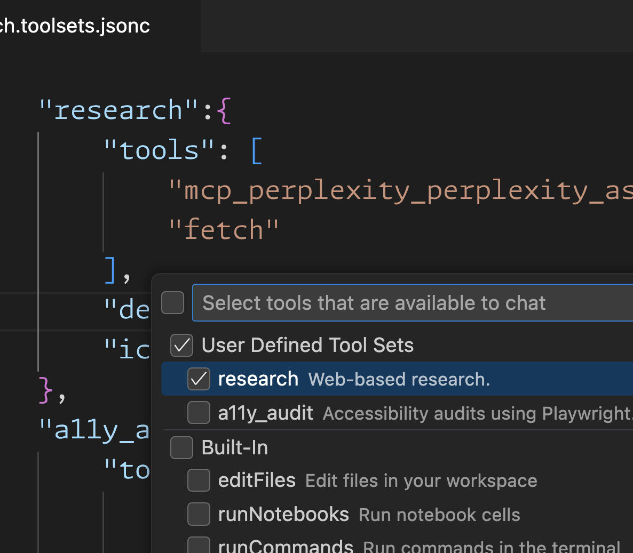
Tools: User controls
Provide user controls to fine-tune and improve tool calls
Per-chat tool selection
Mention tools in prompts
User-defined tool sets
Manually reduce tools required to complete a specific task
Reduce the guessing and reference tools as needed.
Re-use task-specific tools across tasks
Notes:
You have a lot of control over the tools available. You can configure them per project or system wide. You can also select directly which ones you want to use when making a chat request, you can use them in prompts directly, and you can even define tool sets that you can re-use across tasks. For example you may have a “research” set or a “coding” set of tools so you can easily jump between them based on what you are trying to accomplish.

Slide 13
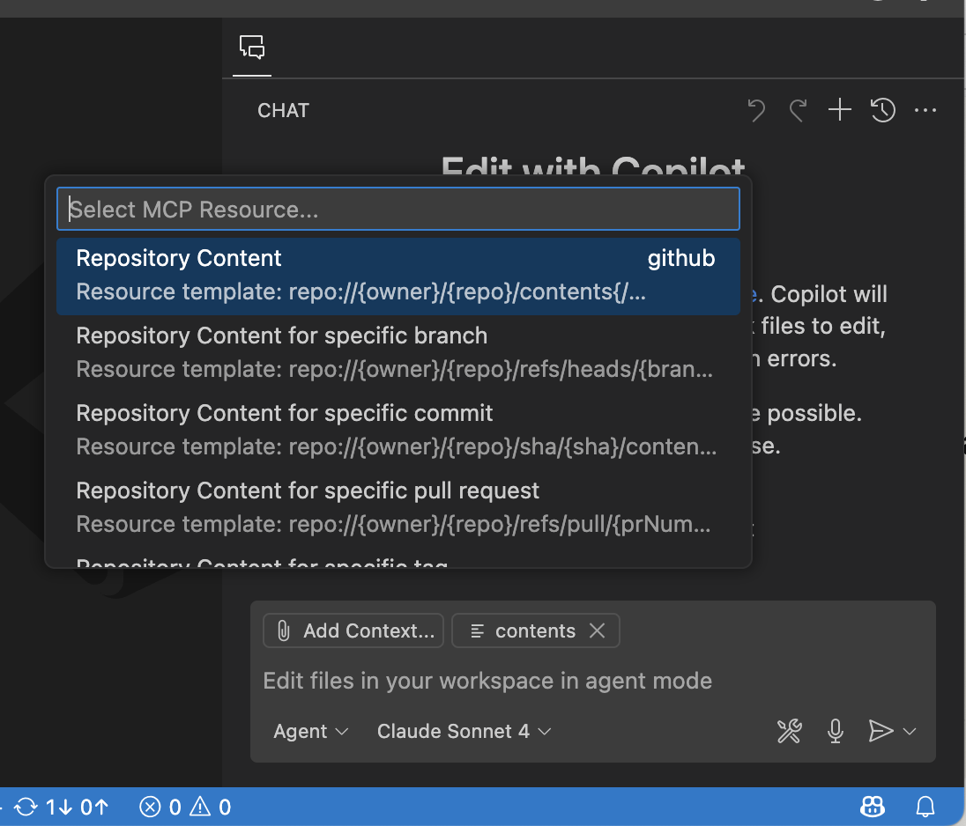
Resources
Ease of adding and returning data
Expose data in a read-only fashion as URIs client/agent/user.
Files
Documents
Database entries/schemas
Images
Notes:
The Model Context Protocol (MCP) provides a standardized way for servers to expose resources to clients. Resources allow servers to share data that provides context to language models, such as files, database schemas, or application-specific information. Each resource is uniquely identified by a URI.
Resources in MCP are designed to be application-driven, with host applications determining how to incorporate context based on their needs.
For example, here the GitHub MCP server exploses repository content directly through a URL that you can fill in and then attach as context to a request.

Slide 14
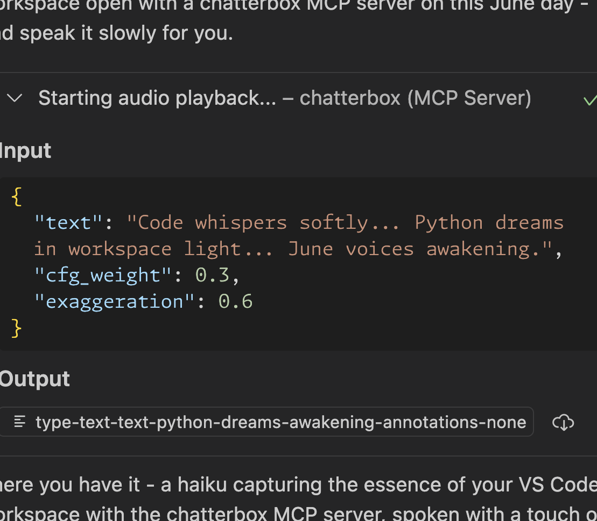
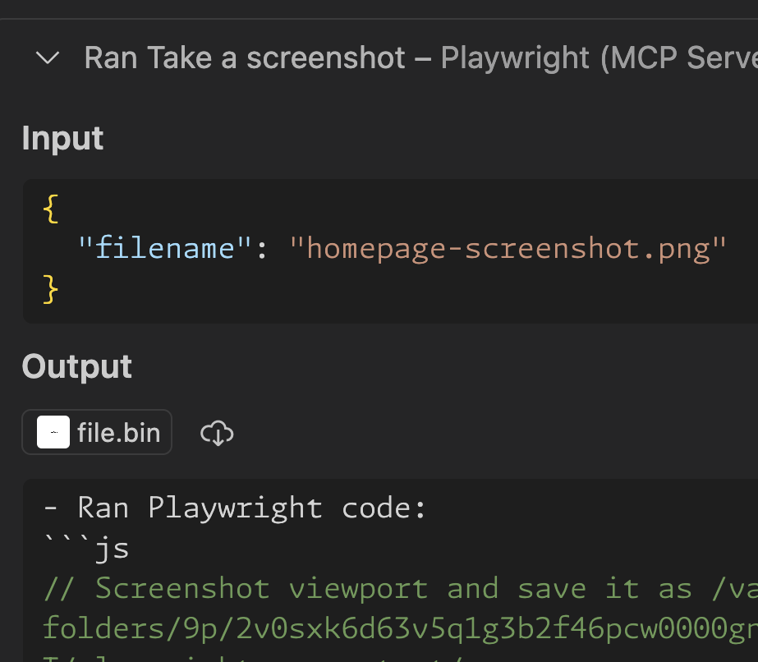
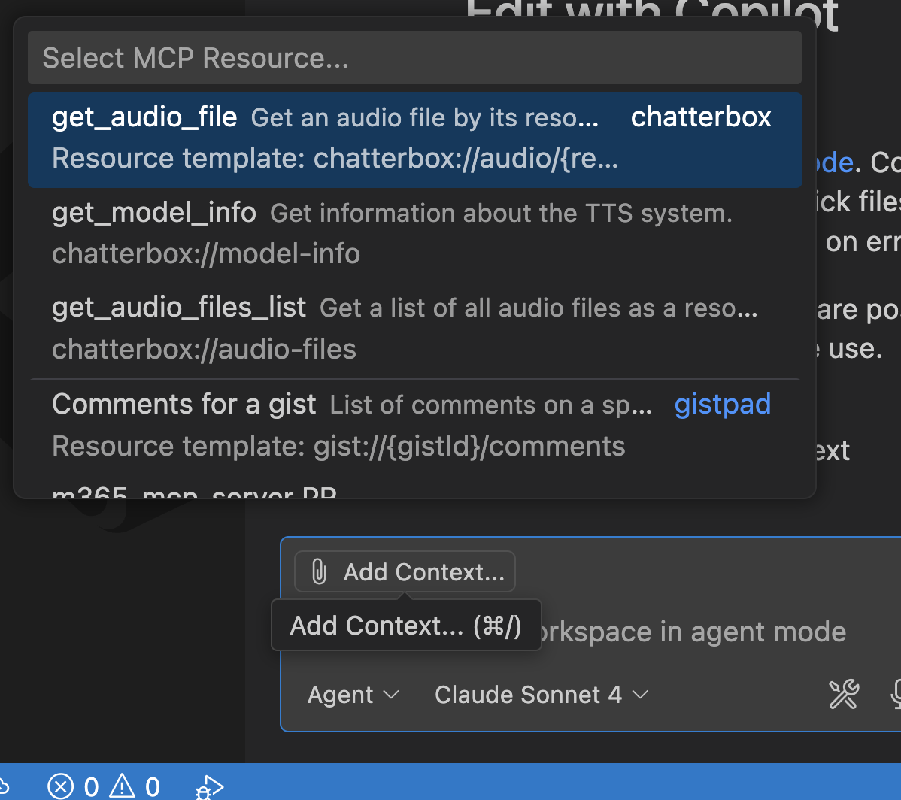
Resources: Use cases
Make data accessible to clients and users
Reduce response tokens
Expose data/files to user
Attach as context
Returning embedded resources lets the agent pull the data.
Provide to assets for the user to act on, not LLM context.
Reducing tool lookups with specific resources attached.
Notes:
What is nice is that you can easily give the agent data directly so it doesn’t have to go fetch it, you can provide data back and attach it.

Slide 15
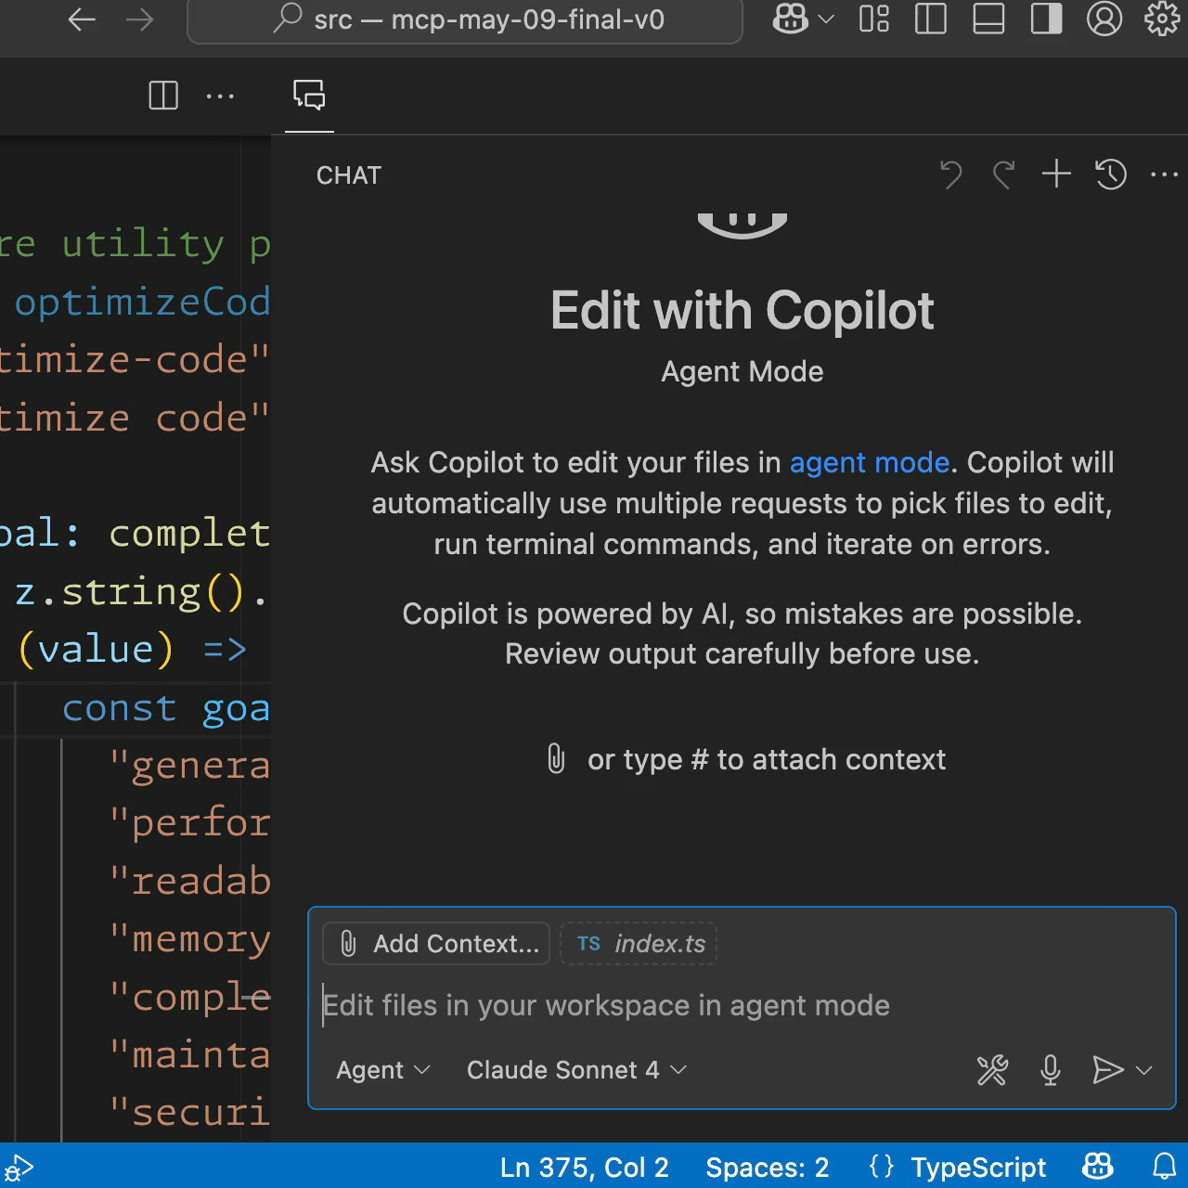
Prompts
Quick
Pre-defined templates for AI tasks, explicitly invoked by the user.
Static presets
Reusable with placeholders
Dynamically generated
Notes:
Prompts allow servers to provide structured messages and instructions for interacting with language models. Clients can discover available prompts, retrieve their contents, and provide arguments to customize them.
Prompts are designed to be user-controlled, meaning they are exposed from servers to clients with the intention of the user being able to explicitly select them for use.
Typically, prompts would be triggered through user-initiated commands in the user interface, which allows users to naturally discover and invoke available prompts.
Here for example I am using the slash command to select a prompt to optize code, then I can fill in information about that prompt and ti will generate a new prompt for me. This is similar to prompts we use in our code base, ut the MCP servers can create and return them.

Slide 16
Prompts: Use cases
From static templates to dynamically generates workflows
/need-info {issue}
/impl-metric {name}
/welcome
/setup
/migrate-db …
/root-cause-wizard
Onboarding prompts
Common workflows
Context-aware workflows
Welcome prompts for users to verify setup and tour the tools
One-shot tasks, parameterized for reusability
Dynamically customized for the current user/codebase
Notes:
Prompts can dynamically pull in real-time data, such as GitHub pull request comments
Far more powerful than static templates.

Slide 17
Demo
Prompts, resources, & more!
Notes:
Let’s see it in action

Slide 18
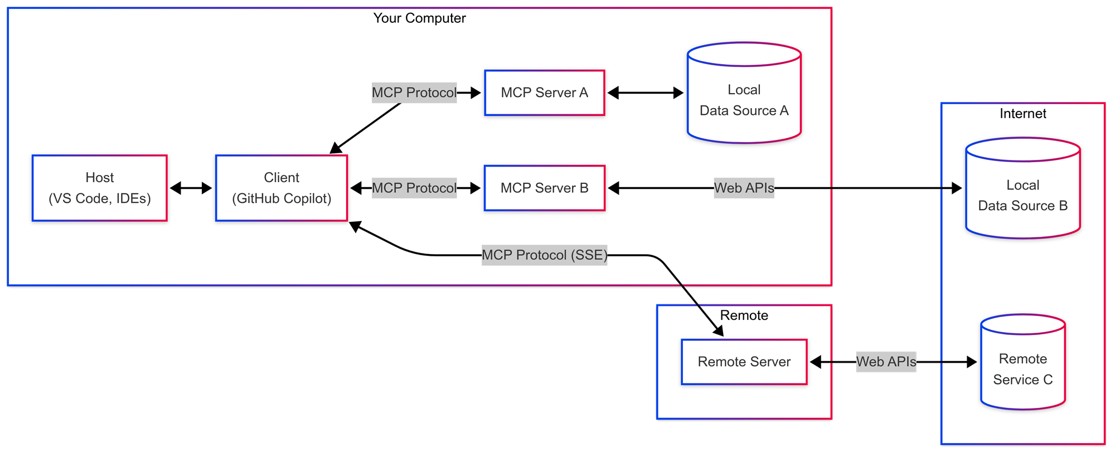

Notes:
We just saw how to setup and use MCP servers, but how and where do they run?
These MCP servers can run on your local machine as an app or inside of a docker container and talk to data sources locally,
or they may be calling web services such as GitHub does to gather or create issues for you.
They can also be executed completely remotely over Server Sent Events or SSE as you may hear it be called.

Slide 19


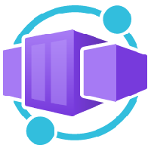


Notes:
These remote servers can be run in Azure Functions, Container Apps, or App Service and be managed by API Management and API Center which are optimized for remote MCP servers.

Slide 20
Real-world scenario
The Microsoft Learn MCP Server
Notes:
Slides 21-25 are from the Microsoft Learn MCP Server explainer deck. Other resources available on the repo.

Slide 21

Real-world scenario: The Microsoft Learn MCP Server
The Microsoft Learn MCP Server is a remote MCP Server that enables clients like GitHub Copilot and other AI agents to bring trusted and up-to-date information directly from Microsoft Learn, Microsoft’s official documentation.
Learn MCP gives AI agents tools to surface the right information:
microsoft_docs_search for focused excerpts The server can search Microsoft content and return up to 10 chunks of high-quality information using microsoft_docs_search tool. Content chunks include a title, URL, and self-contained passage.
microsoft_docs_fetch for full technical documentation When broader context is needed, the Learn MCP Server can fetch complete pages, giving agents more contextual information with microsoft_docs_fetch tool.
microsoft_code_sample_search for code samples The server returns relevant, language-specific code snippets from Microsoft Learn with microsoft_code_sample_search tool, helping agents surface accurate code for scenarios like deployments, scripting, or configuration.
Notes:
What is the Microsoft Learn MCP Server?
Learn MCP Server is a remote MCP server that allows AI agents to tap directly into official Microsoft product knowledge, inside your development environment or workflow.
It’s simple to use, as it doesn’t require custom connectors or installing extra components. The service uses lightweight, streamable HTTP, so it works with almost any MCP-compatible tool.
It provides tools to AI agents so they can surface the right information:
Focused excerpts: The server can search Microsoft content and return up to 10 chunks of high-quality information—each with a title, URL, and self-contained passage.
Full technical documentation: When broader context is needed, the Learn MCP Server can fetch complete pages, giving agents richer, more contextual information than a chunk alone could provide.
Code samples: The server returns relevant, language-specific code snippets from Microsoft Learn, helping agents surface accurate code for scenarios like deployments, scripting, or configuration.

Slide 22
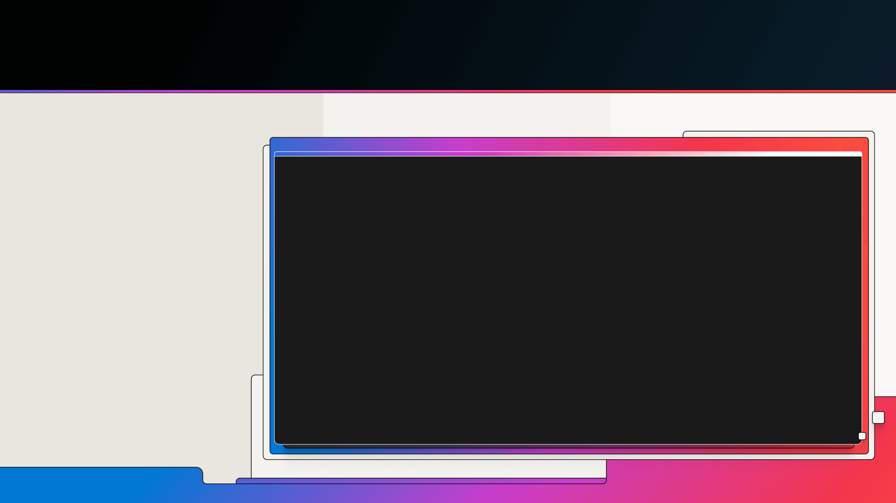
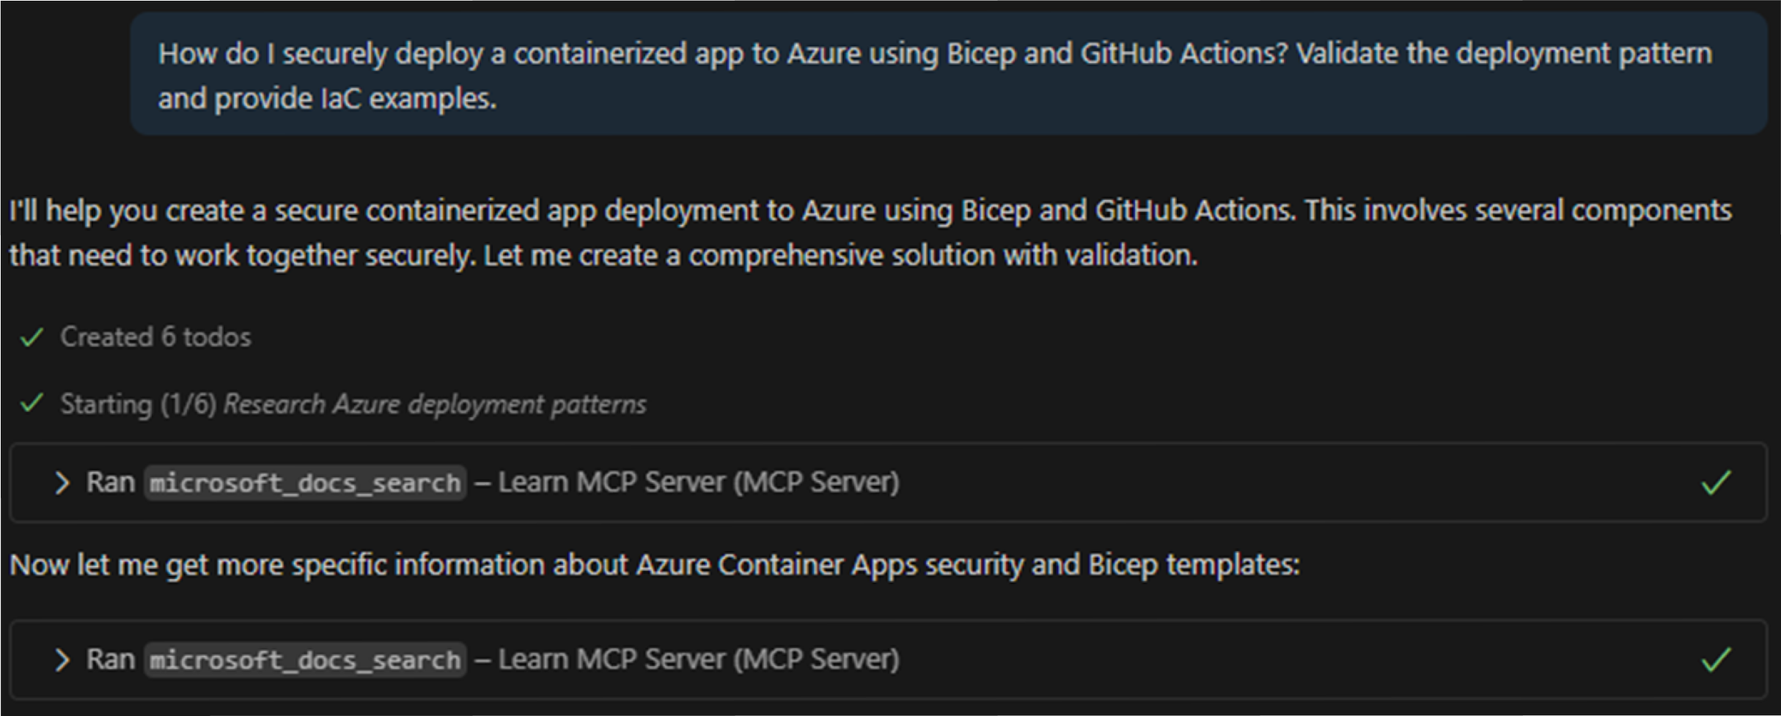
Real-world scenario: Microsoft Learn MCP Server demo
Secure containerized app deployment
Developers can use the Learn MCP Server within Visual Studio Code to retrieve validated, cited deployment patterns directly from Microsoft Learn documentation. Here, a developer wants to know how to securely deploy containerized apps to Azure using Bicep and GitHub Actions. View the prompt and the first steps GitHub Copilot takes to build the solution.
Step 1: GitHub Copilot accesses the Learn MCP server, using the search tool twice.
Notes:
Let’s look at a specific example of using Learn MCP Server. Developers can use the Learn MCP Server within Visual Studio to retrieve validated, cited deployment patterns—such as securely deploying containerized apps to Azure using Bicep and GitHub Actions—directly from Microsoft Learn documentation.
Here a developer enters the prompt “How do I securely deploy a containerized app to Azure using Bicep and GitHub Actions? Validate the deployment pattern and provide IaC examples.” This is a multifaceted question about infrastructure-as-code and DevOps practices. Here’s what happens:
The agent first breaks down the query and determines that it involves Azure containers, Bicep (which is an Azure resource template language), and GitHub Actions (CI/CD). It needs accurate info on these topics. It then uses the documentation search tool (microsoft_docs_search) to find the relevant information on Microsoft Learn. In this case, it actually runs two search queries to gather the best guidance on Azure container deployment and security patterns. Those search results (from official docs about Bicep deployment, security, GitHub Actions workflows, etc.) feed into Copilot’s answer.

Slide 23
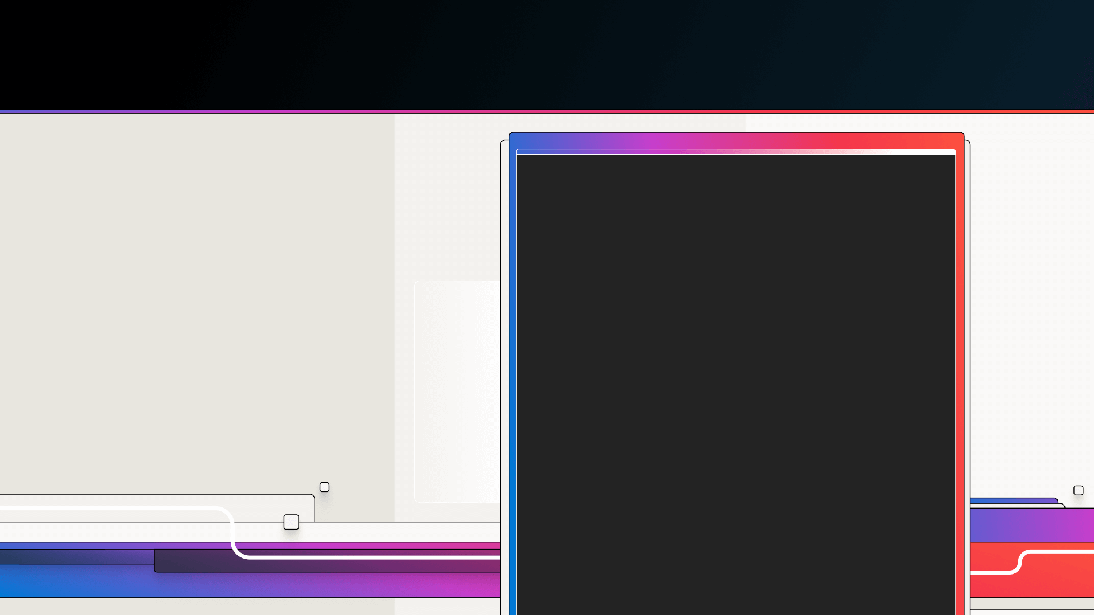

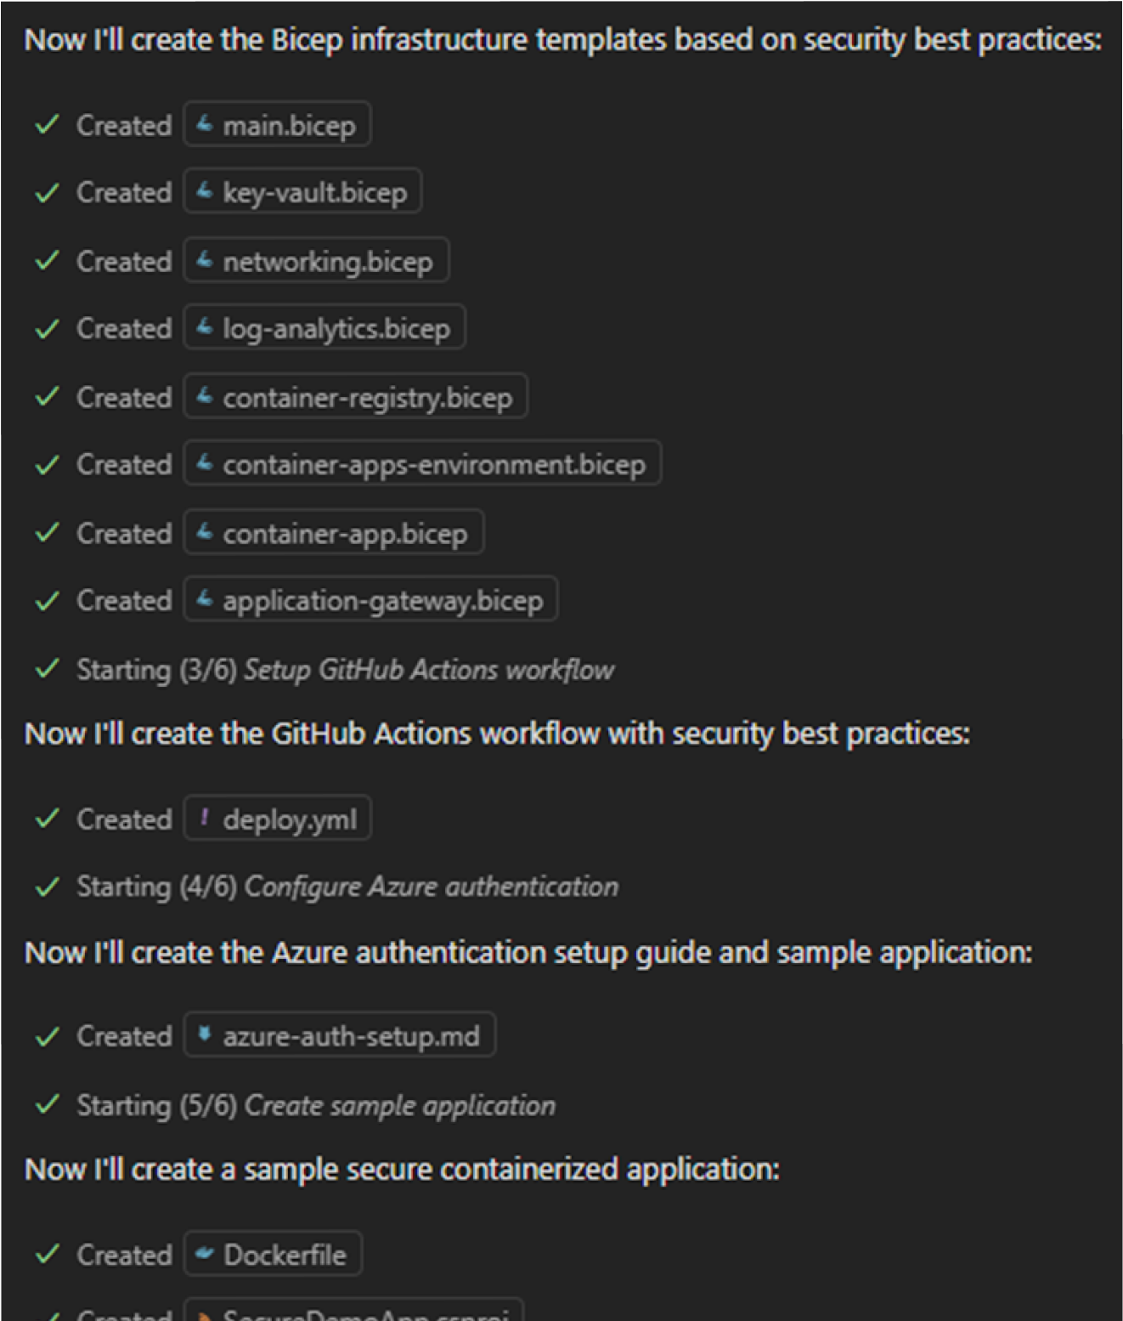
Real-world scenario: Microsoft Learn MCP Server demo
Step 2: Create the files
Step 2: GitHub Copilot creates the files based on information from Learn.
Notes:
After retrieving the guidance, the AI agent moves on to implementation. In this step, GitHub Copilot starts creating the necessary files and configuration for the deployment. Using the results from Microsoft documentation, it generates things like infrastructure-as-code templates (Bicep files) and workflow files for GitHub Actions. So, in Step 2, you see the agent auto-generating code files that align with the searched guidance, saving the developer from writing them manually from scratch.

Slide 24

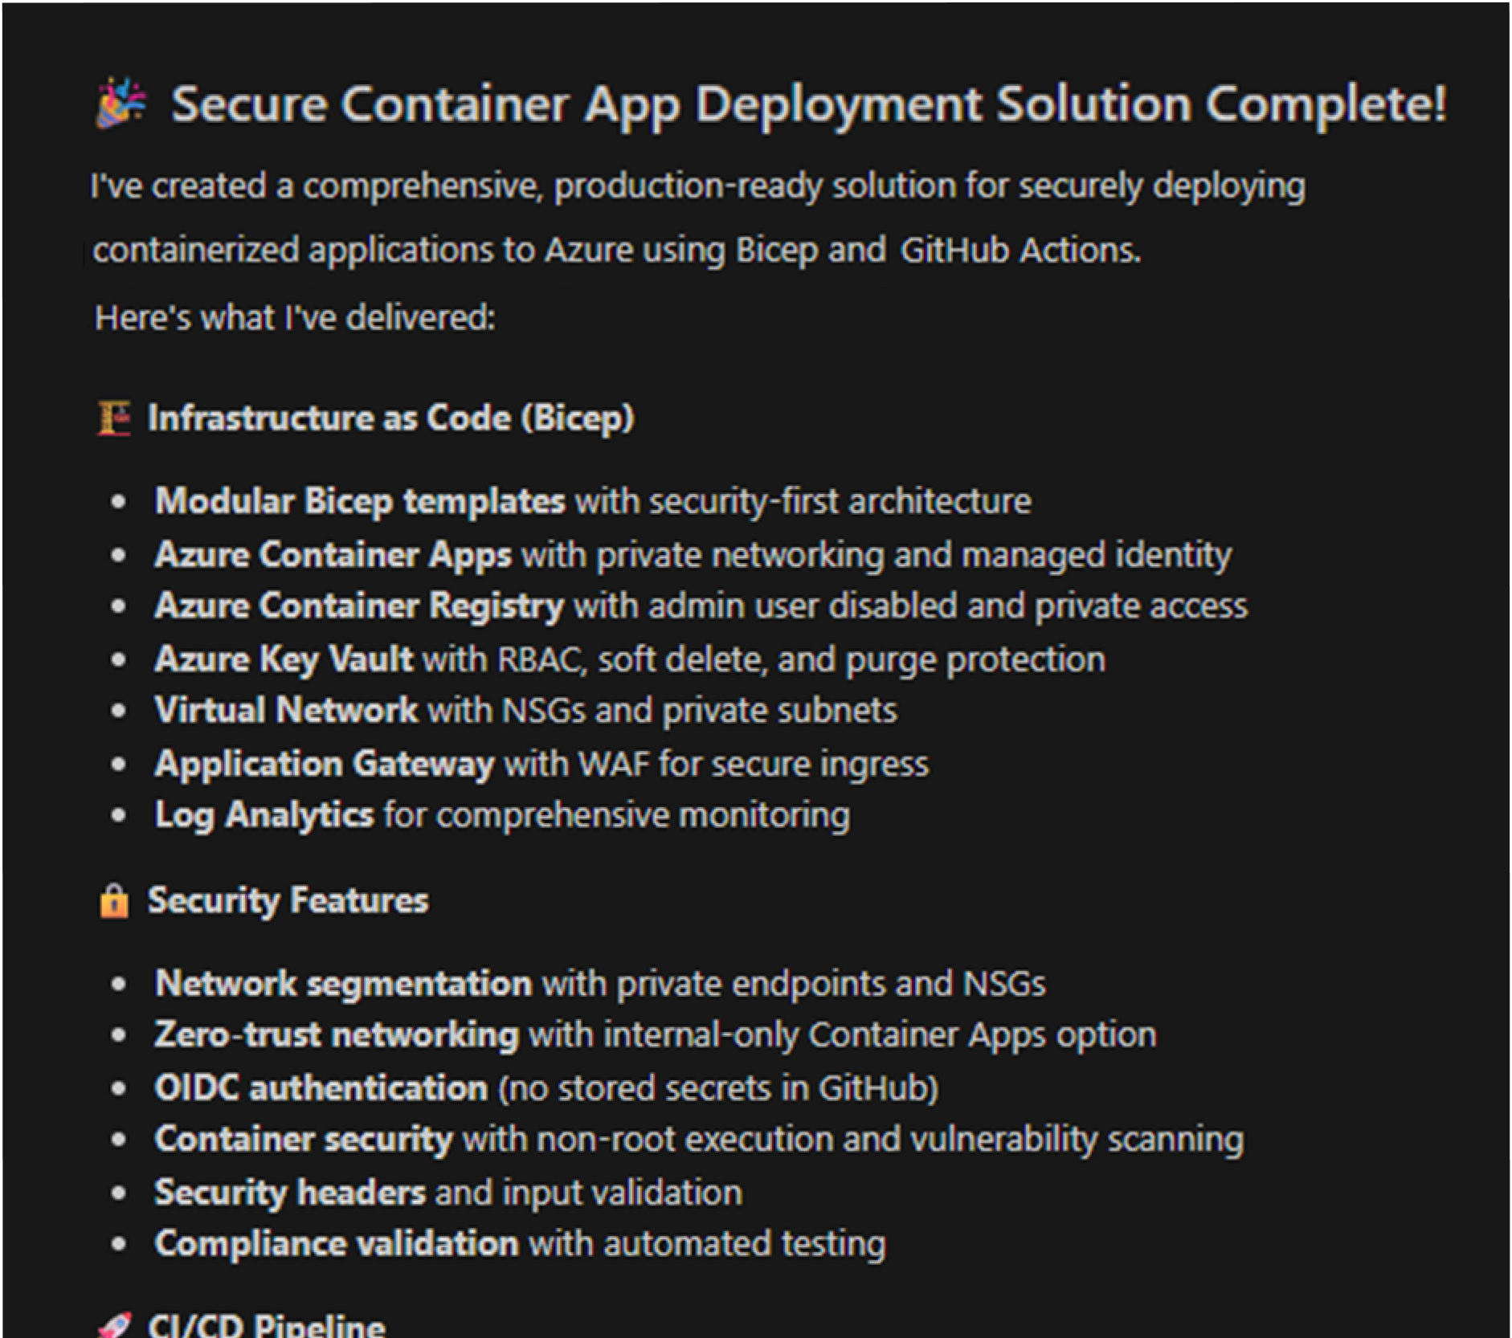

Real-world scenario: Microsoft Learn MCP Server demo
Step 3: Summarize the solution and process
Step 3: GitHub Copilot describes what it has done.
Notes:
Once the agent has assembled the solution, it provides a quick summary of what it did. GitHub Copilot explains the deployment setup it created and the process it followed. The AI not only builds the solution but also narrates back the key points — which helps the developer understands the outcome and reasoning. This summary helps confirm that how the pattern was implemented and lets the user verify each step.

Slide 25

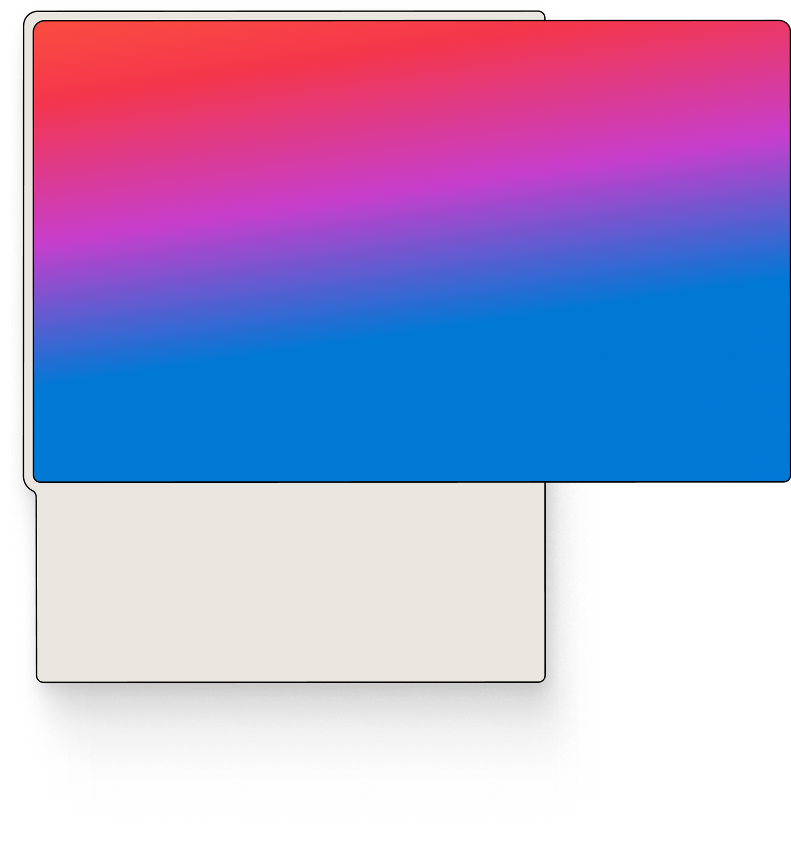
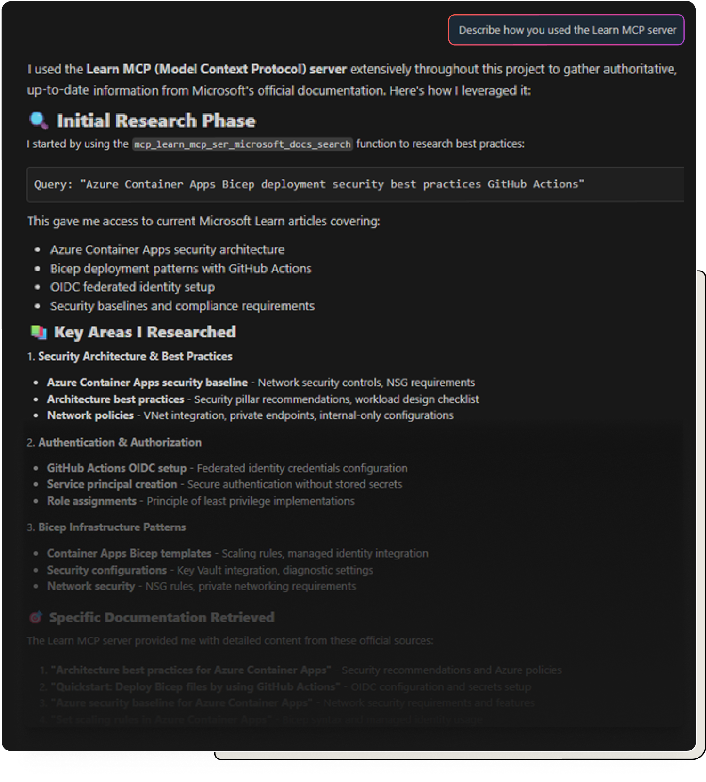

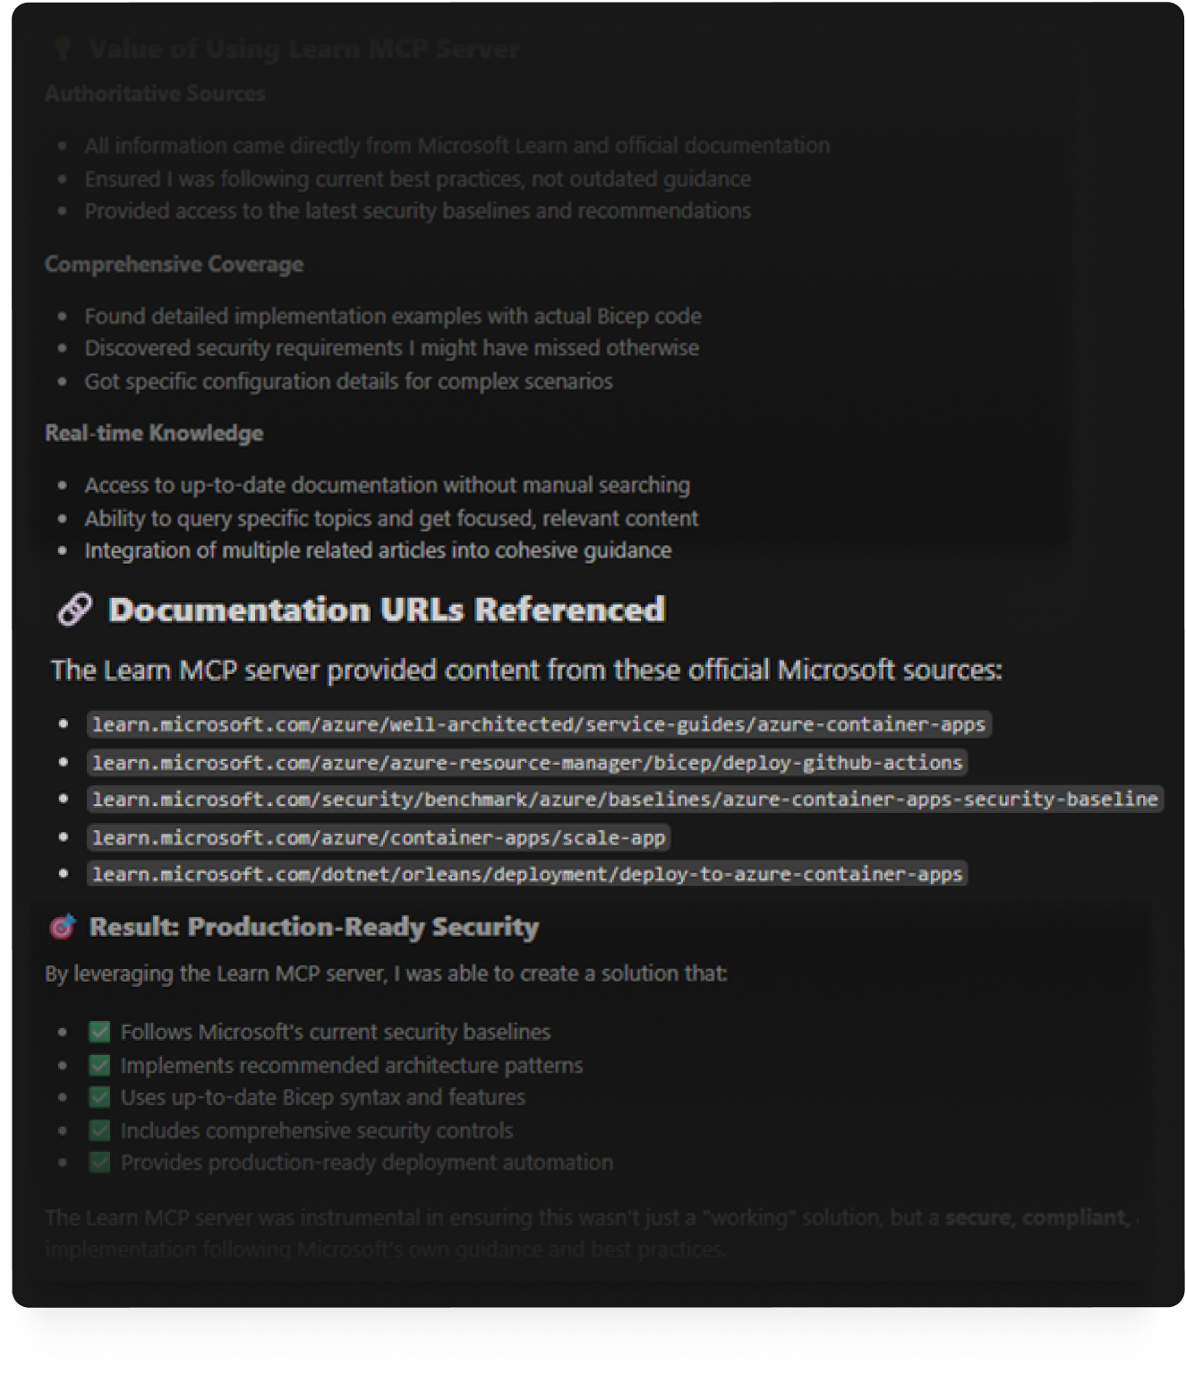
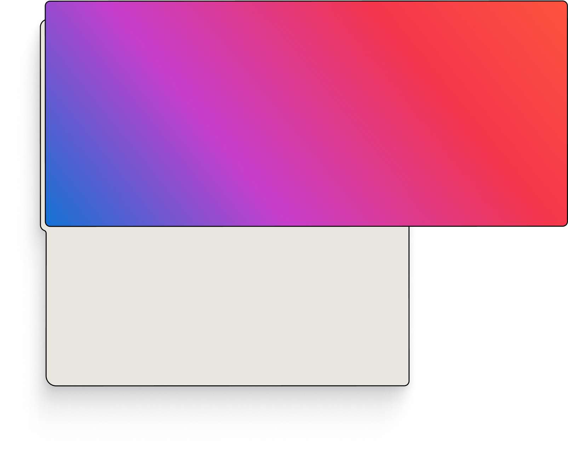
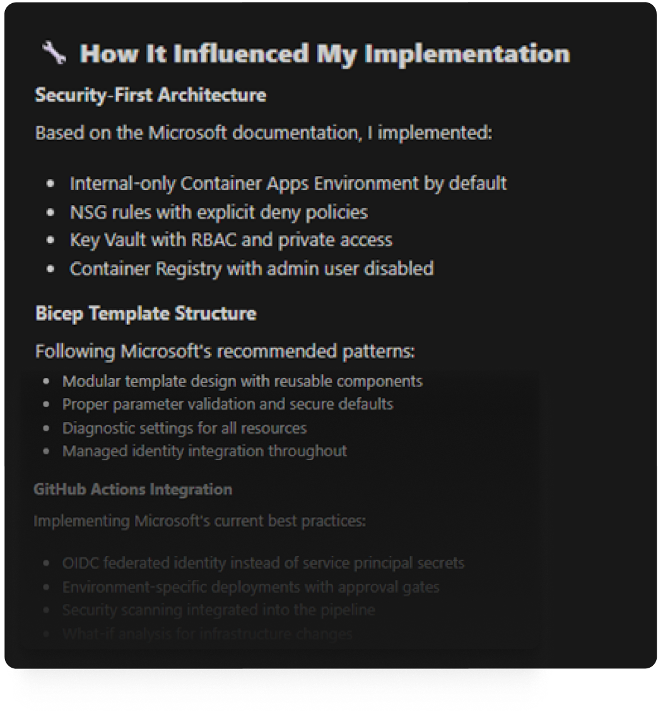
Pro tip: Ask the agent how it used the Learn MCP Server
Notes:
Here’s a useful tip for transparency: ask the agent to describe how it used its tools. In our scenario, after the solution is built, we can ask, “How did you use the Learn MCP Server to do that?” The agent will then clearly lay out what it did: 1: It describes areas it researched and specific documents from Learn that it referenced. 2. It describes how the documentation influenced the implementation’s architecture, patterns and GitHub integration. 3. It describes why it used the MCP server and the specific URLs it retrieved. By doing asking the agent how it used its resources, you have transparency into the agent’s processes. You can double check its work, and you learn a little bit about how an agent works.

Slide 26
Building an MCP
aka.ms/letslearnmcp-csharp aka.ms/letslearnmcp-java
aka.ms/letslearnmcp-python
aka.ms/letslearnmcp-javascript
Notes:
[Katie] As mentioned earlier, you can build this yourself, for your company, for developers, or for anyone that may use MCP servers.

Slide 27
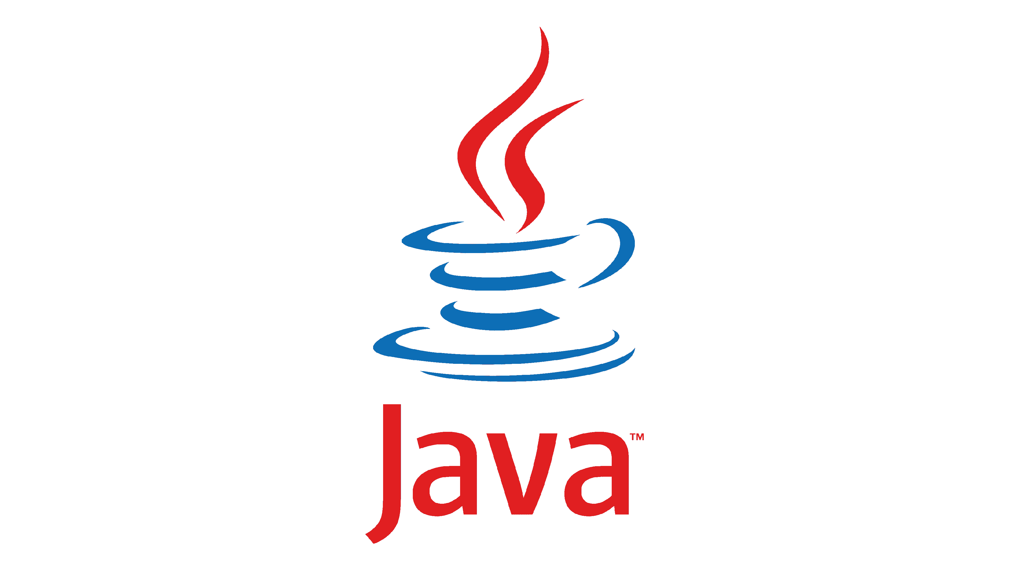

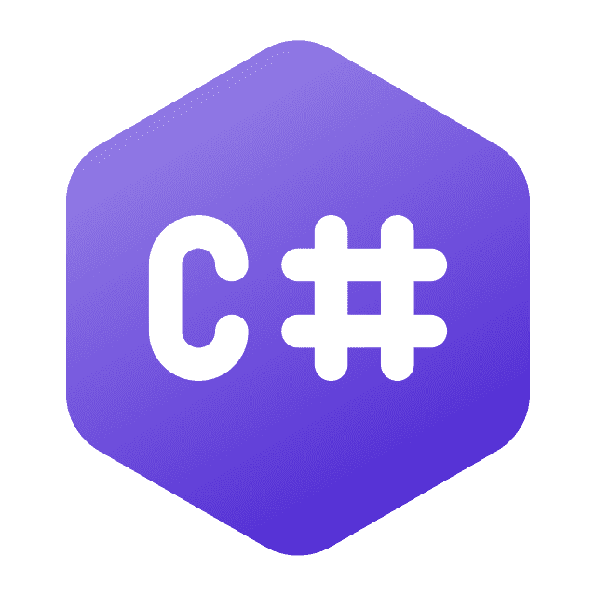
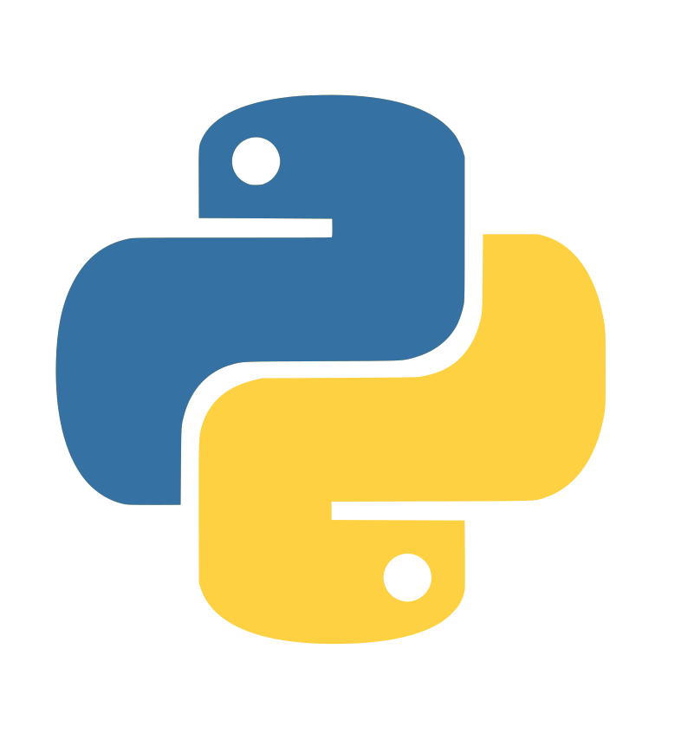

Official SDKs
Notes:
There are SDKs for just about any programming language, and here at Microsoft, we officially maintain the C# SDK

Slide 28
Official C# SDK for MCP
Clients
Servers
Local – Stdio Transport
Remote – Server Sent Events
Remote – Streamable HTTP
https://aka.ms/csharp-sdk-mcp
Notes:
With the C# SDK you can actually build and integrate client functionality into your apps so they can communicate with MCP server directly.
And of course you can also build MCP servers using any of the different transports out there. That is what we are going to do today.

Slide 29
NuGet Packages
ModelContextProtocol.Core
ModelContextProtocol
ModelContextProtocol.AspNetCore
Notes:
There are 3 main NuGet Packages. There is a core base that the main MCP package uses. ModelContextProtocol package will be the one that we use today and provides access to STDIO out of the box. The AspNetCore package builds on top of this and supplies support for HTTP transports with MCPs.

Slide 30
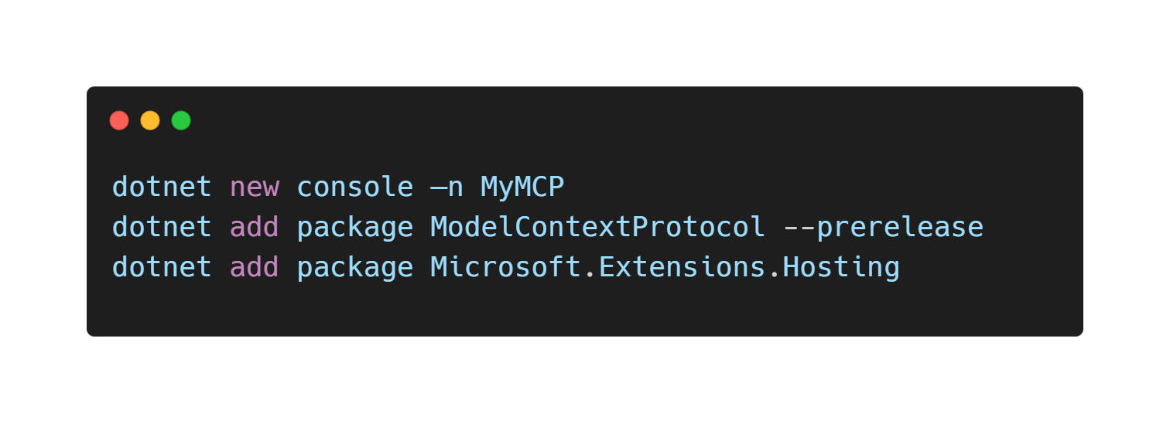
Get Started
Notes:
[James]
To get started it is as easy as creating a new console app and adding in the NuGet packages we need.

Slide 31
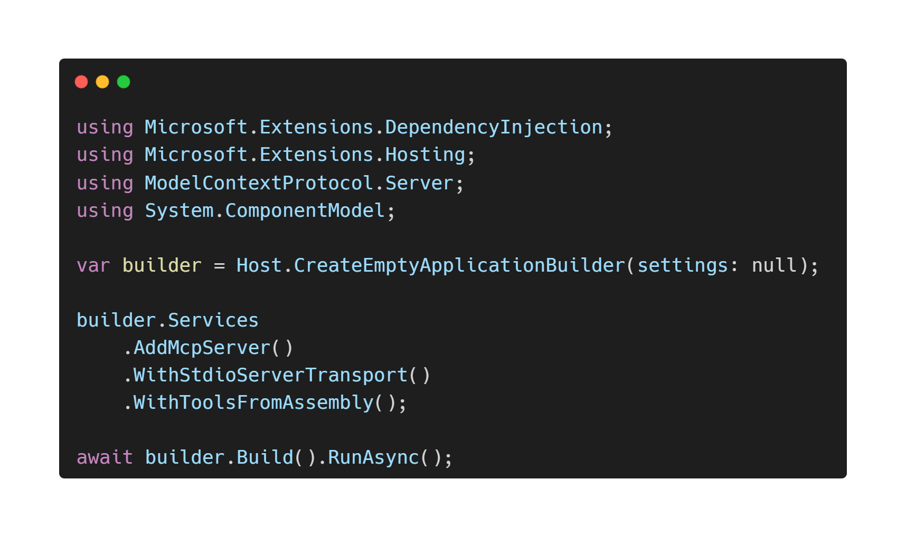
Notes:
Bring in our namespaces and scaffold out our main setup code for our server tools and any dependencies we may have.

Slide 32
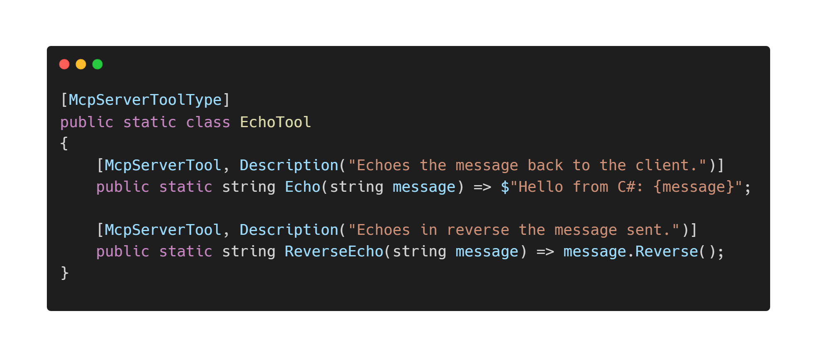
Notes:
Finally are the tools themselves. We mark the class as a ToolType to give indication that there are Tools available and then put the attribute of Tool on each of them that will be exposed.

Slide 33
Demo
Building an MCP Server
Notes:
Alright, let’s build one!

Slide 34
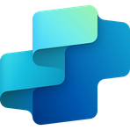
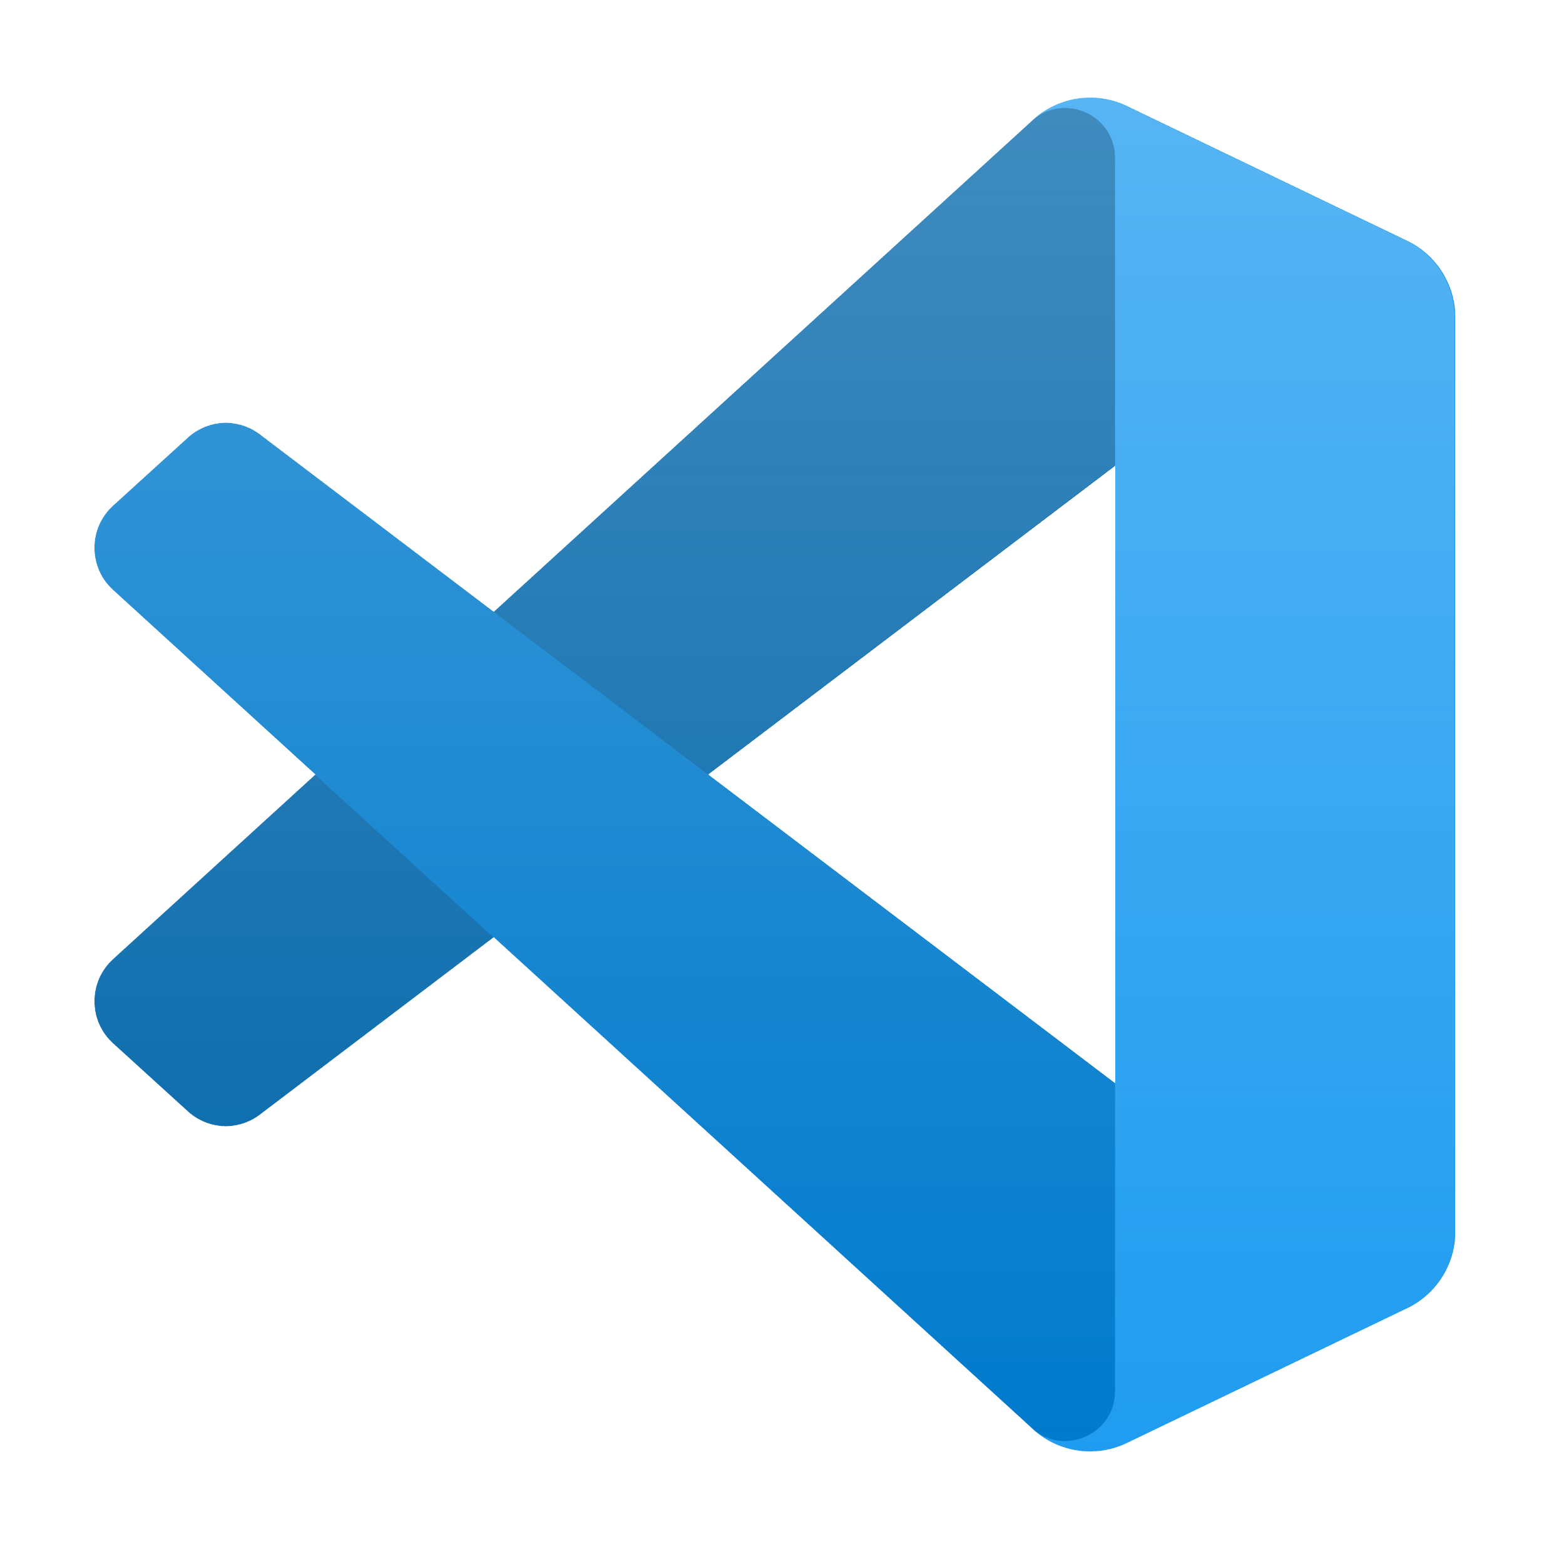

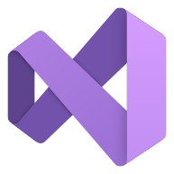






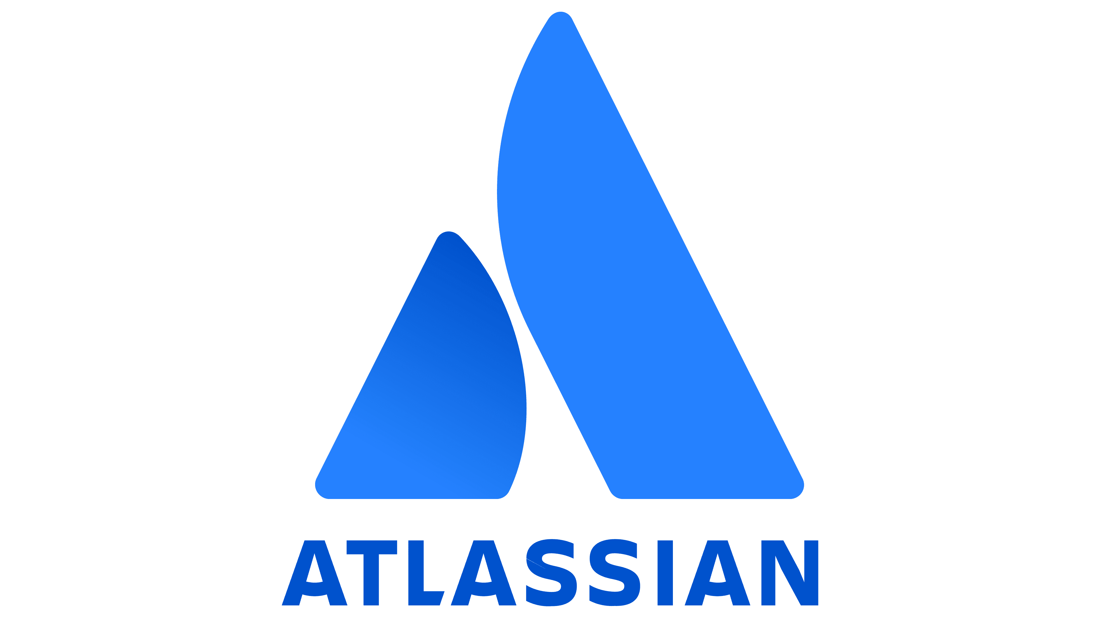
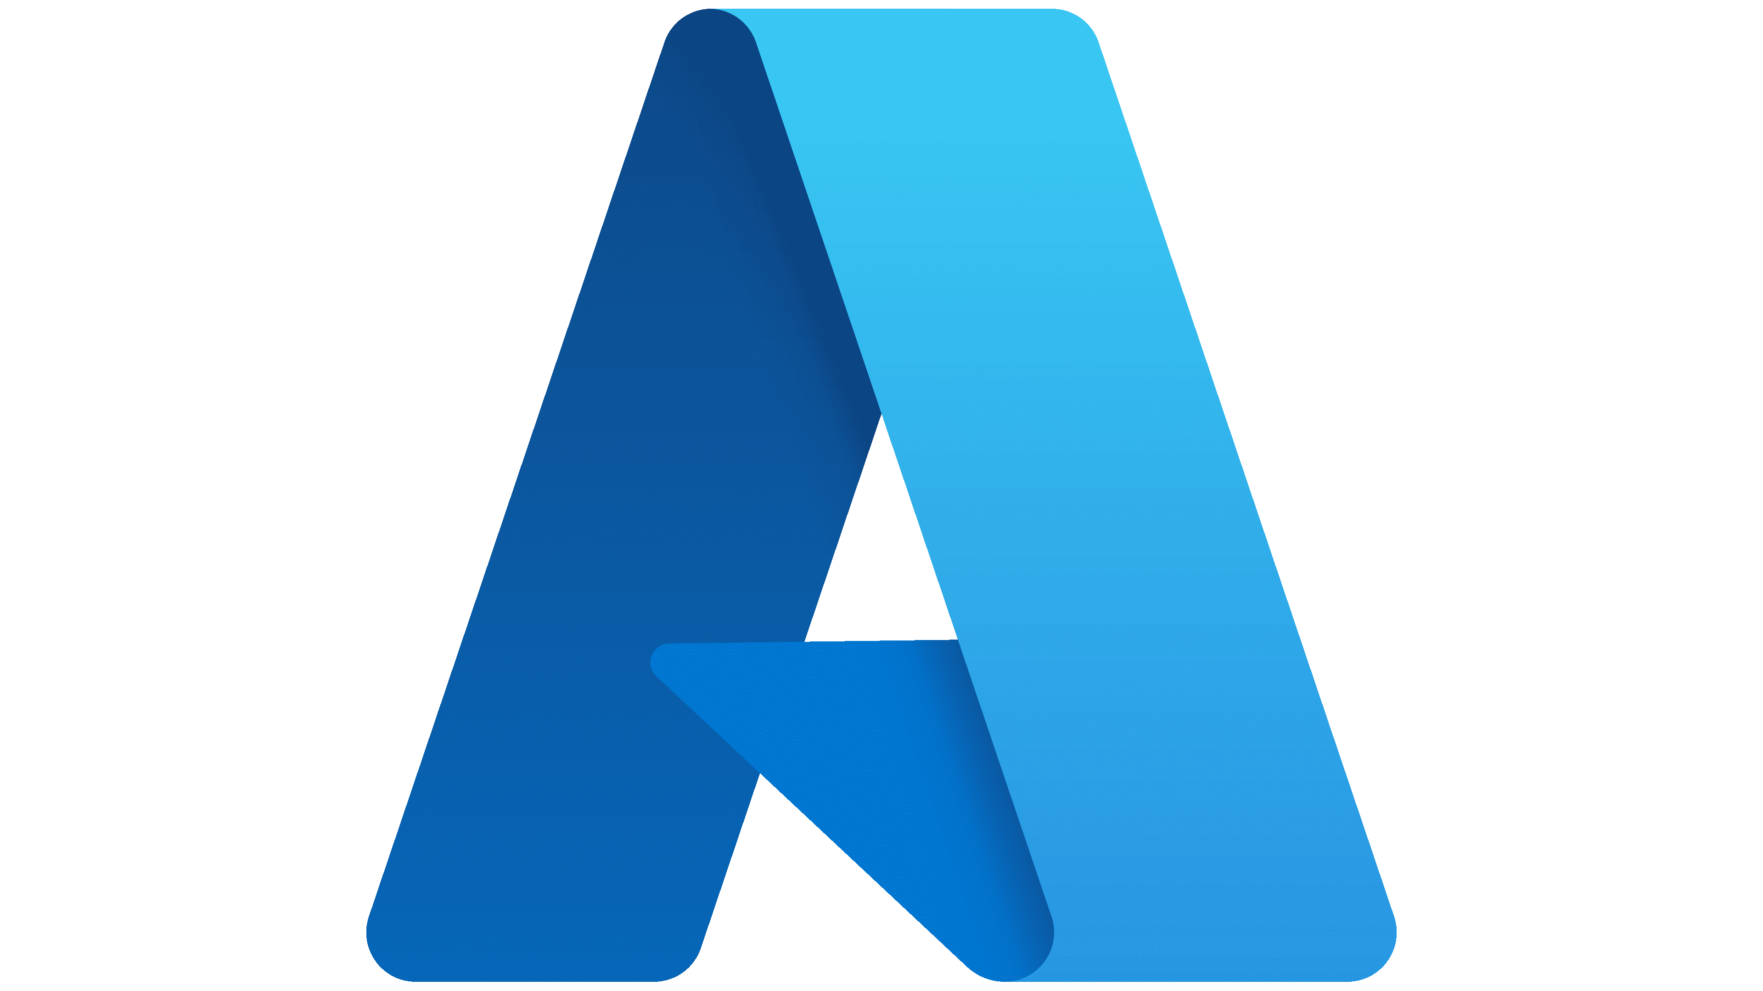
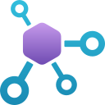






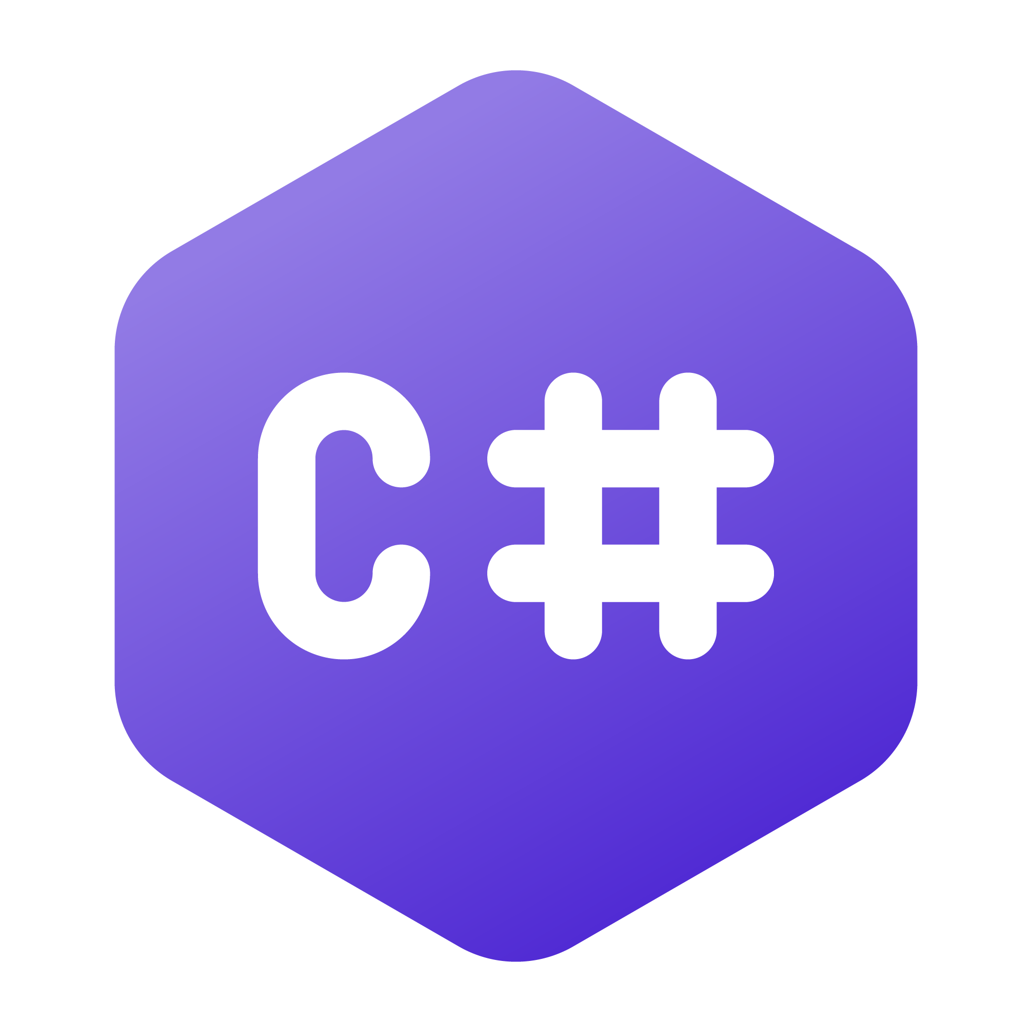
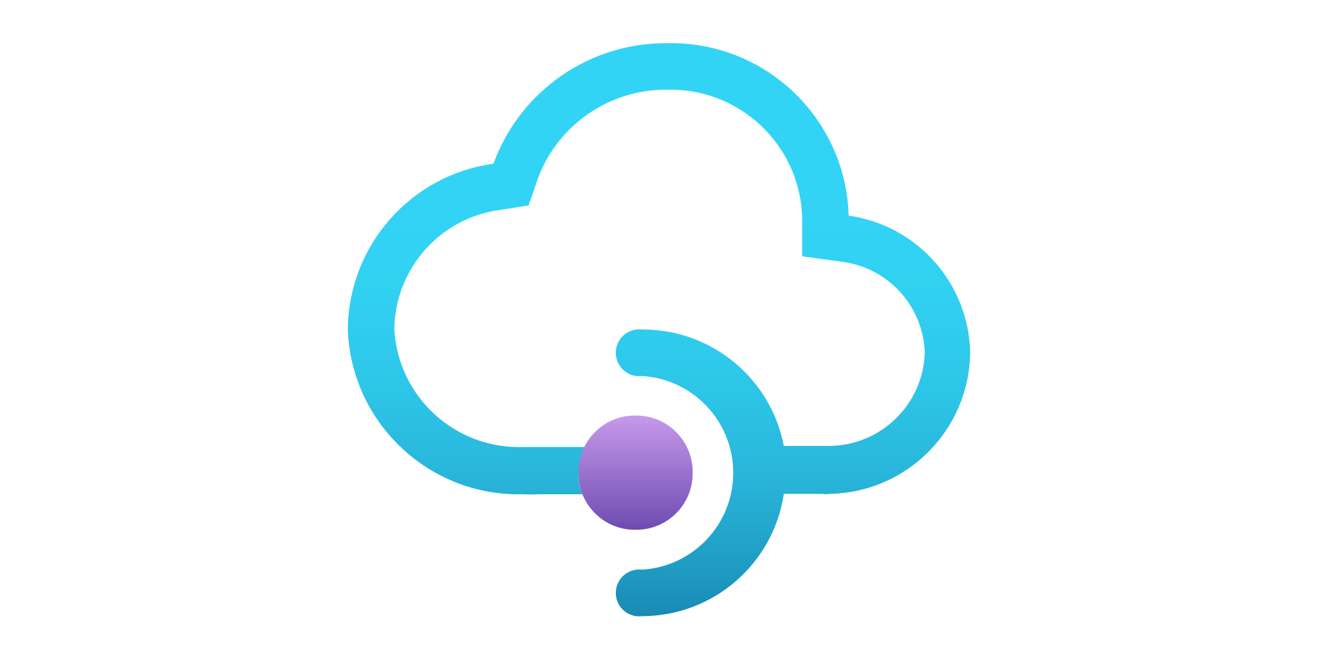

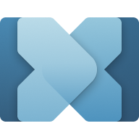

Model Context Protocol At Microsoft
Copilot Studio
VS Code
Foundry Agent
Visual Studio
Windows
GitHub Copilot
Microsoft Teams
Semantic Kernel
MCP Clients & Host
Community
Enterprise
Windows
Tools
Registry
C# MCP SDK
Azure API Management
Azure Functions
Microsoft Connectors
Build Local & Remote MCPs
MPC enables seamless Integration between LLM Apps and external data sources
Model Context Protocol
Notes:
Value Proposition of MCP: At Microsoft, we are all in on MCP. The Model Context Protocol has revolutionized our Agentic workflows, accelerating them faster than anything we have seen before. MCP seamlessly enables integration between intelligent applications and external data sources, providing a robust framework for creating dynamic and responsive solutions.
Building Local and Remote MCPs: Whether you are building local or remote MCPs, Microsoft is here to support you. We have collaborated with Anthropic and the .NET community to develop the official C# SDK, opening up the possibilities of MCPs to our millions of .NET developers. With Azure API Management and Azure Functions, we make it easy to build secure remote MCPs, ensuring that your solutions are both scalable and secure.
MCP Tools Accelerate Productivity: MCP tools are designed to accelerate productivity for your Agentic workflows. Whether you are a consumer or a developer, Microsoft is fully invested in MCP. We have launched several flagship MCPs across Azure, GitHub, and Windows. In collaboration with Anthropic, we are fostering an MCP ecosystem that is discoverable through a community registry on GitHub. Additionally, we offer a private, secure registry with Azure API Center and tools on Windows to manage MCPs across your devices.
Delivering Productivity Across Microsoft Applications: MCPs are delivering significant productivity gains across various Microsoft applications. From Azure to GitHub and Windows, MCPs are integrated into our core platforms, enhancing the capabilities and efficiency of our intelligent applications.
Conclusion: In summary, Microsoft's commitment to MCP and our collaboration with Anthropic is driving the growth and evolution of this protocol. We are dedicated to providing the tools and support needed to build and deploy MCPs, ensuring that our developers and users can harness the full potential of this transformative technology.

Slide 35
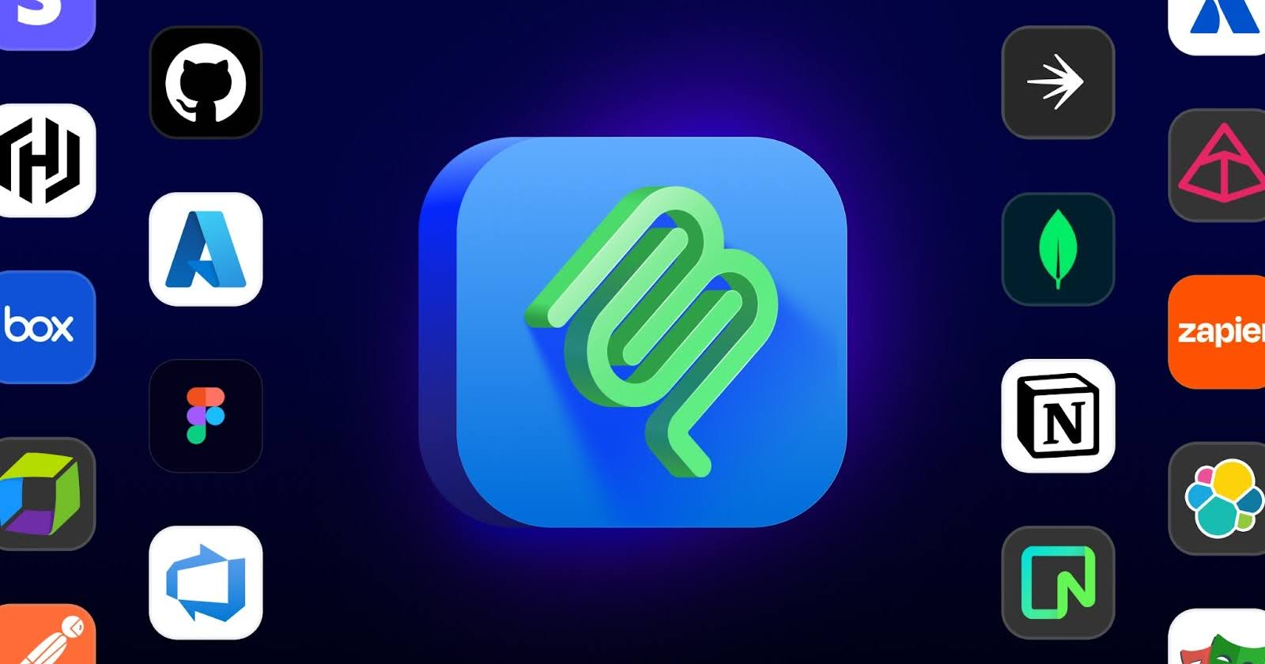
GitHub MCP Registry
Servers and tools from the community that connect models to files, APIs, databases, and more.
Launched September 2025
Discoverable inside VS Code, one-click installs
Works with any MCP-compatible host (including GitHub Copilot)
Meant to reduce duplication and increase confidence when choosing and consuming MCP servers.
github.com/mcp

Slide 36
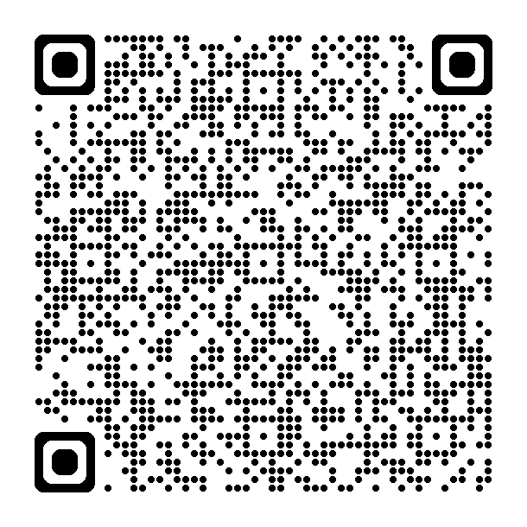
SPEAKERS: Update tutorial link for your programming language
Learn more
Microsoft wants to hear from you!
Today's tutorial
aka.ms/letslearnmcp-csharp
More training
aka.ms/mcp-for-beginners
Microsoft Learn MCP Server
aka.ms/Season-of-AI-MSLearnMCPServer
VS Code MCP Support
aka.ms/vscode-mcp
Model Context Protocol
modelcontextprotocol.io
Online AI Community
aka.ms/AIDiscord
Participate in the Season of AI post-event survey to share your feedback on this topic and content.
https://aka.ms/soai/mcp/attendeesurvey

